Slide 1
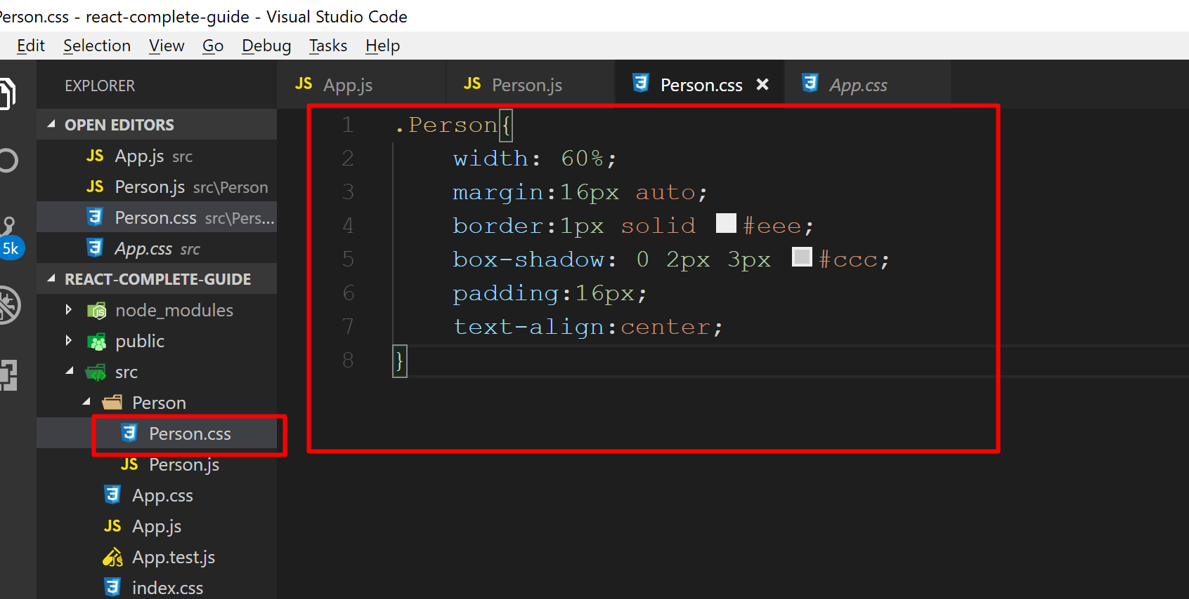
Add a new file Person.css and add the .Person class

Slide 2
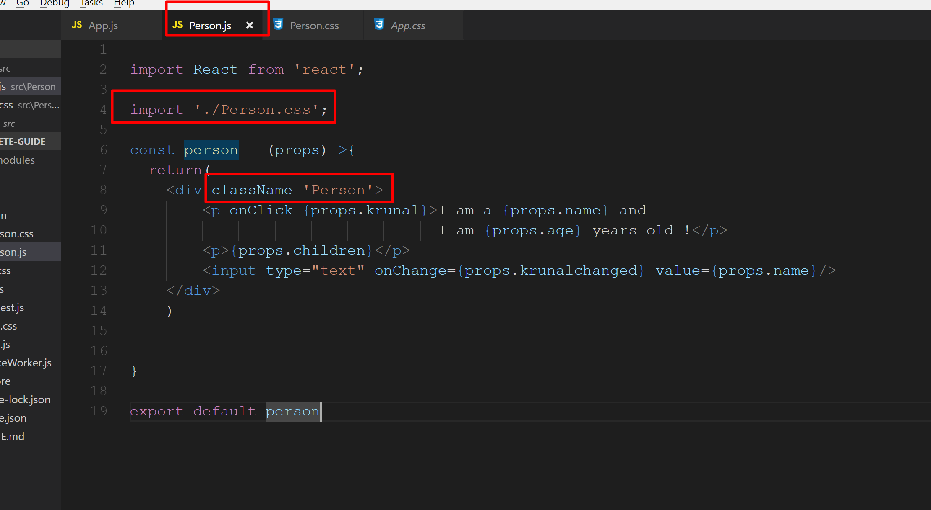
In the Person.js file import Person.css and add the className attribute to the div.

Slide 3
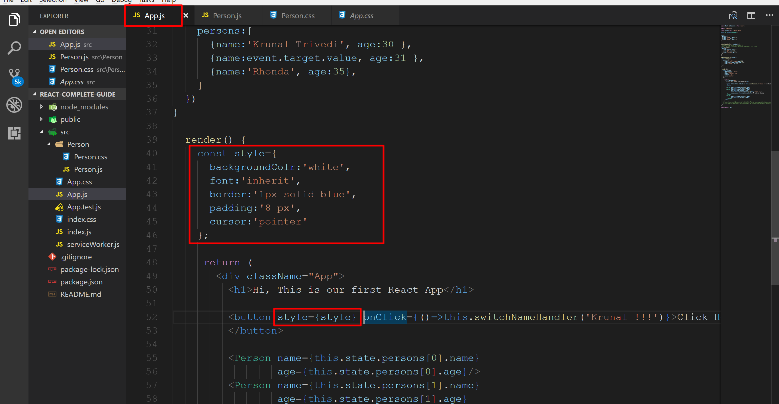
We can also use inline style here In the App.js file within render method create a new constant called style and apply it on the button control’s style attribute. Here JSX gives style attribute to button control.

Slide 4
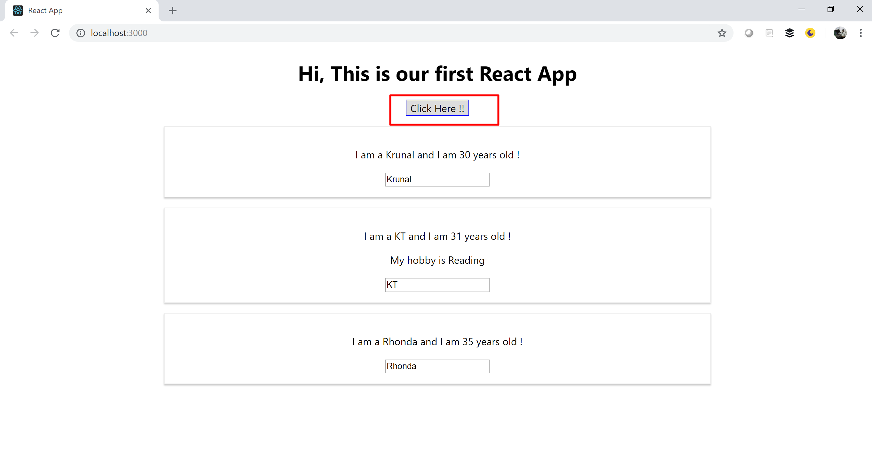
Run the application and check the output.

Slide 5
Rendering List and Conditional Content

Slide 6
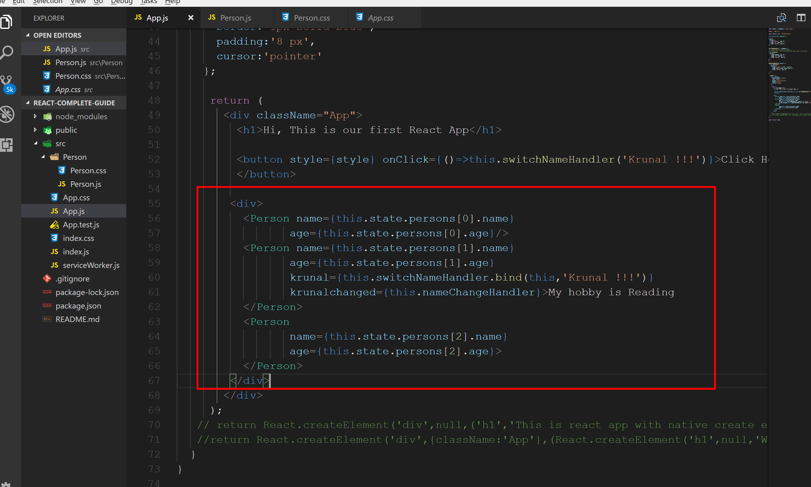
Go to App.js file and wrap all <Person> component entries within a <div>

Slide 7
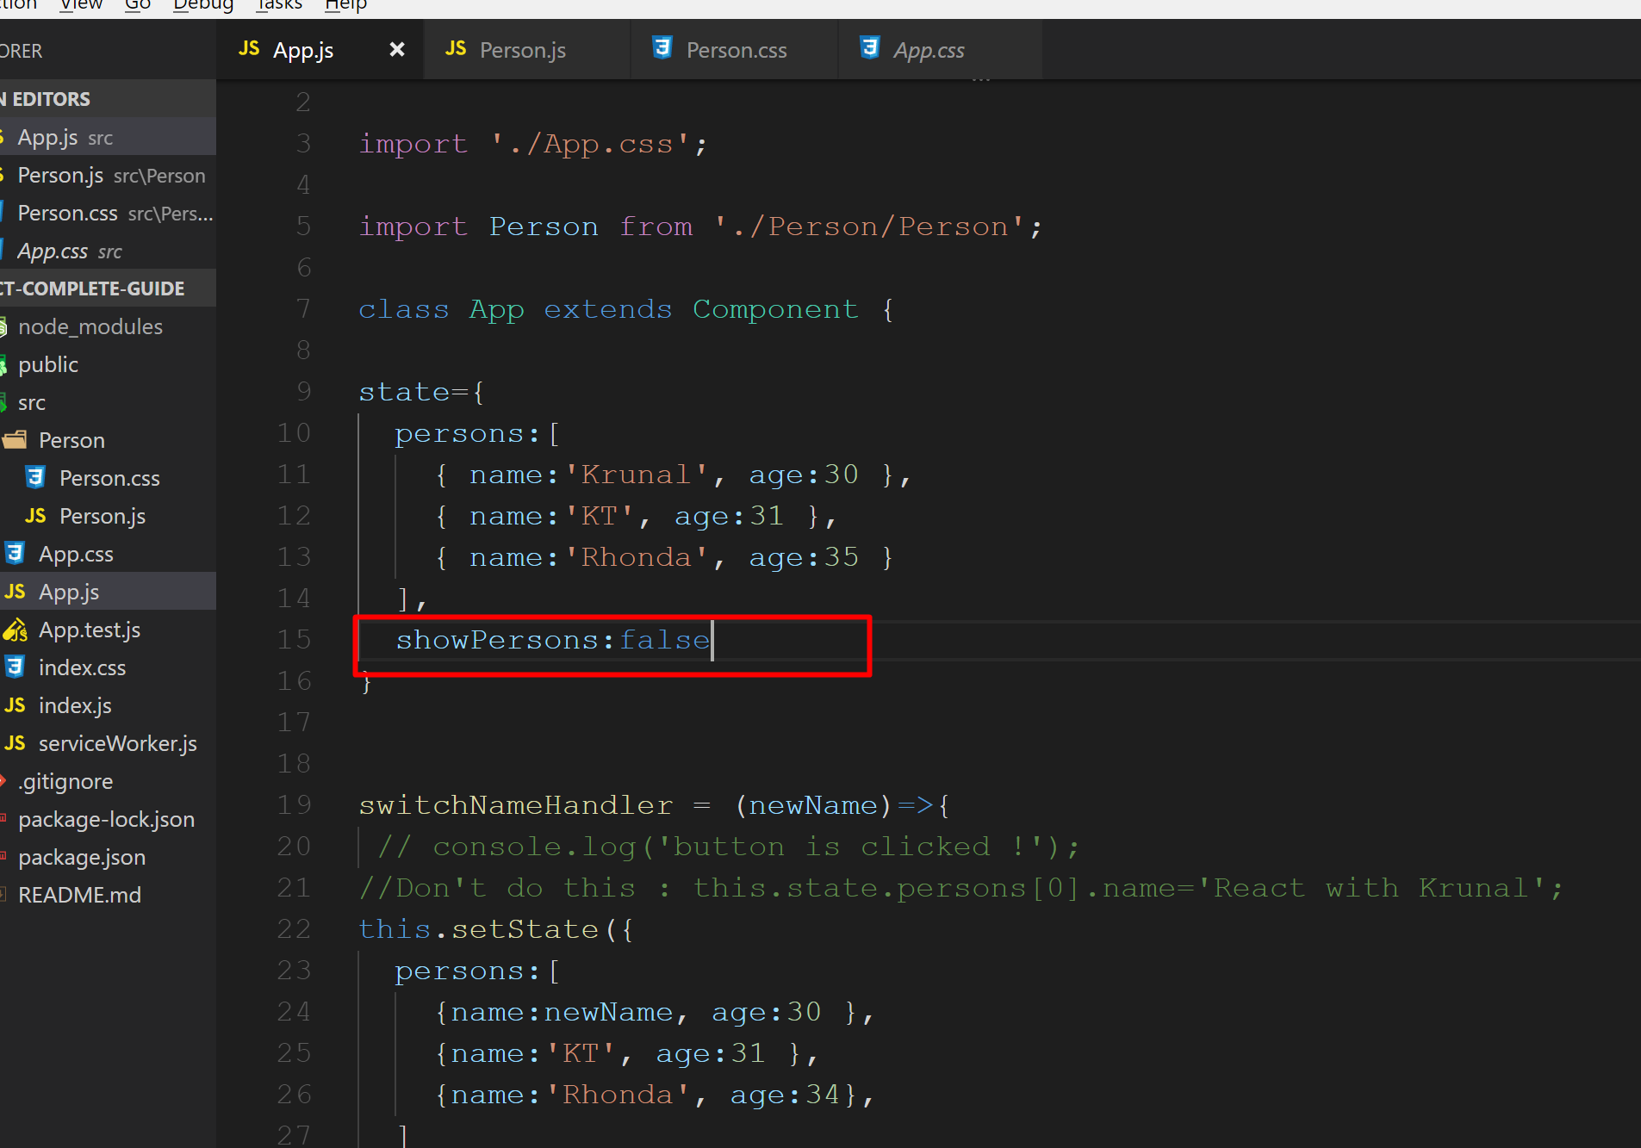
In the state we add one more property showPersons:false

Slide 8
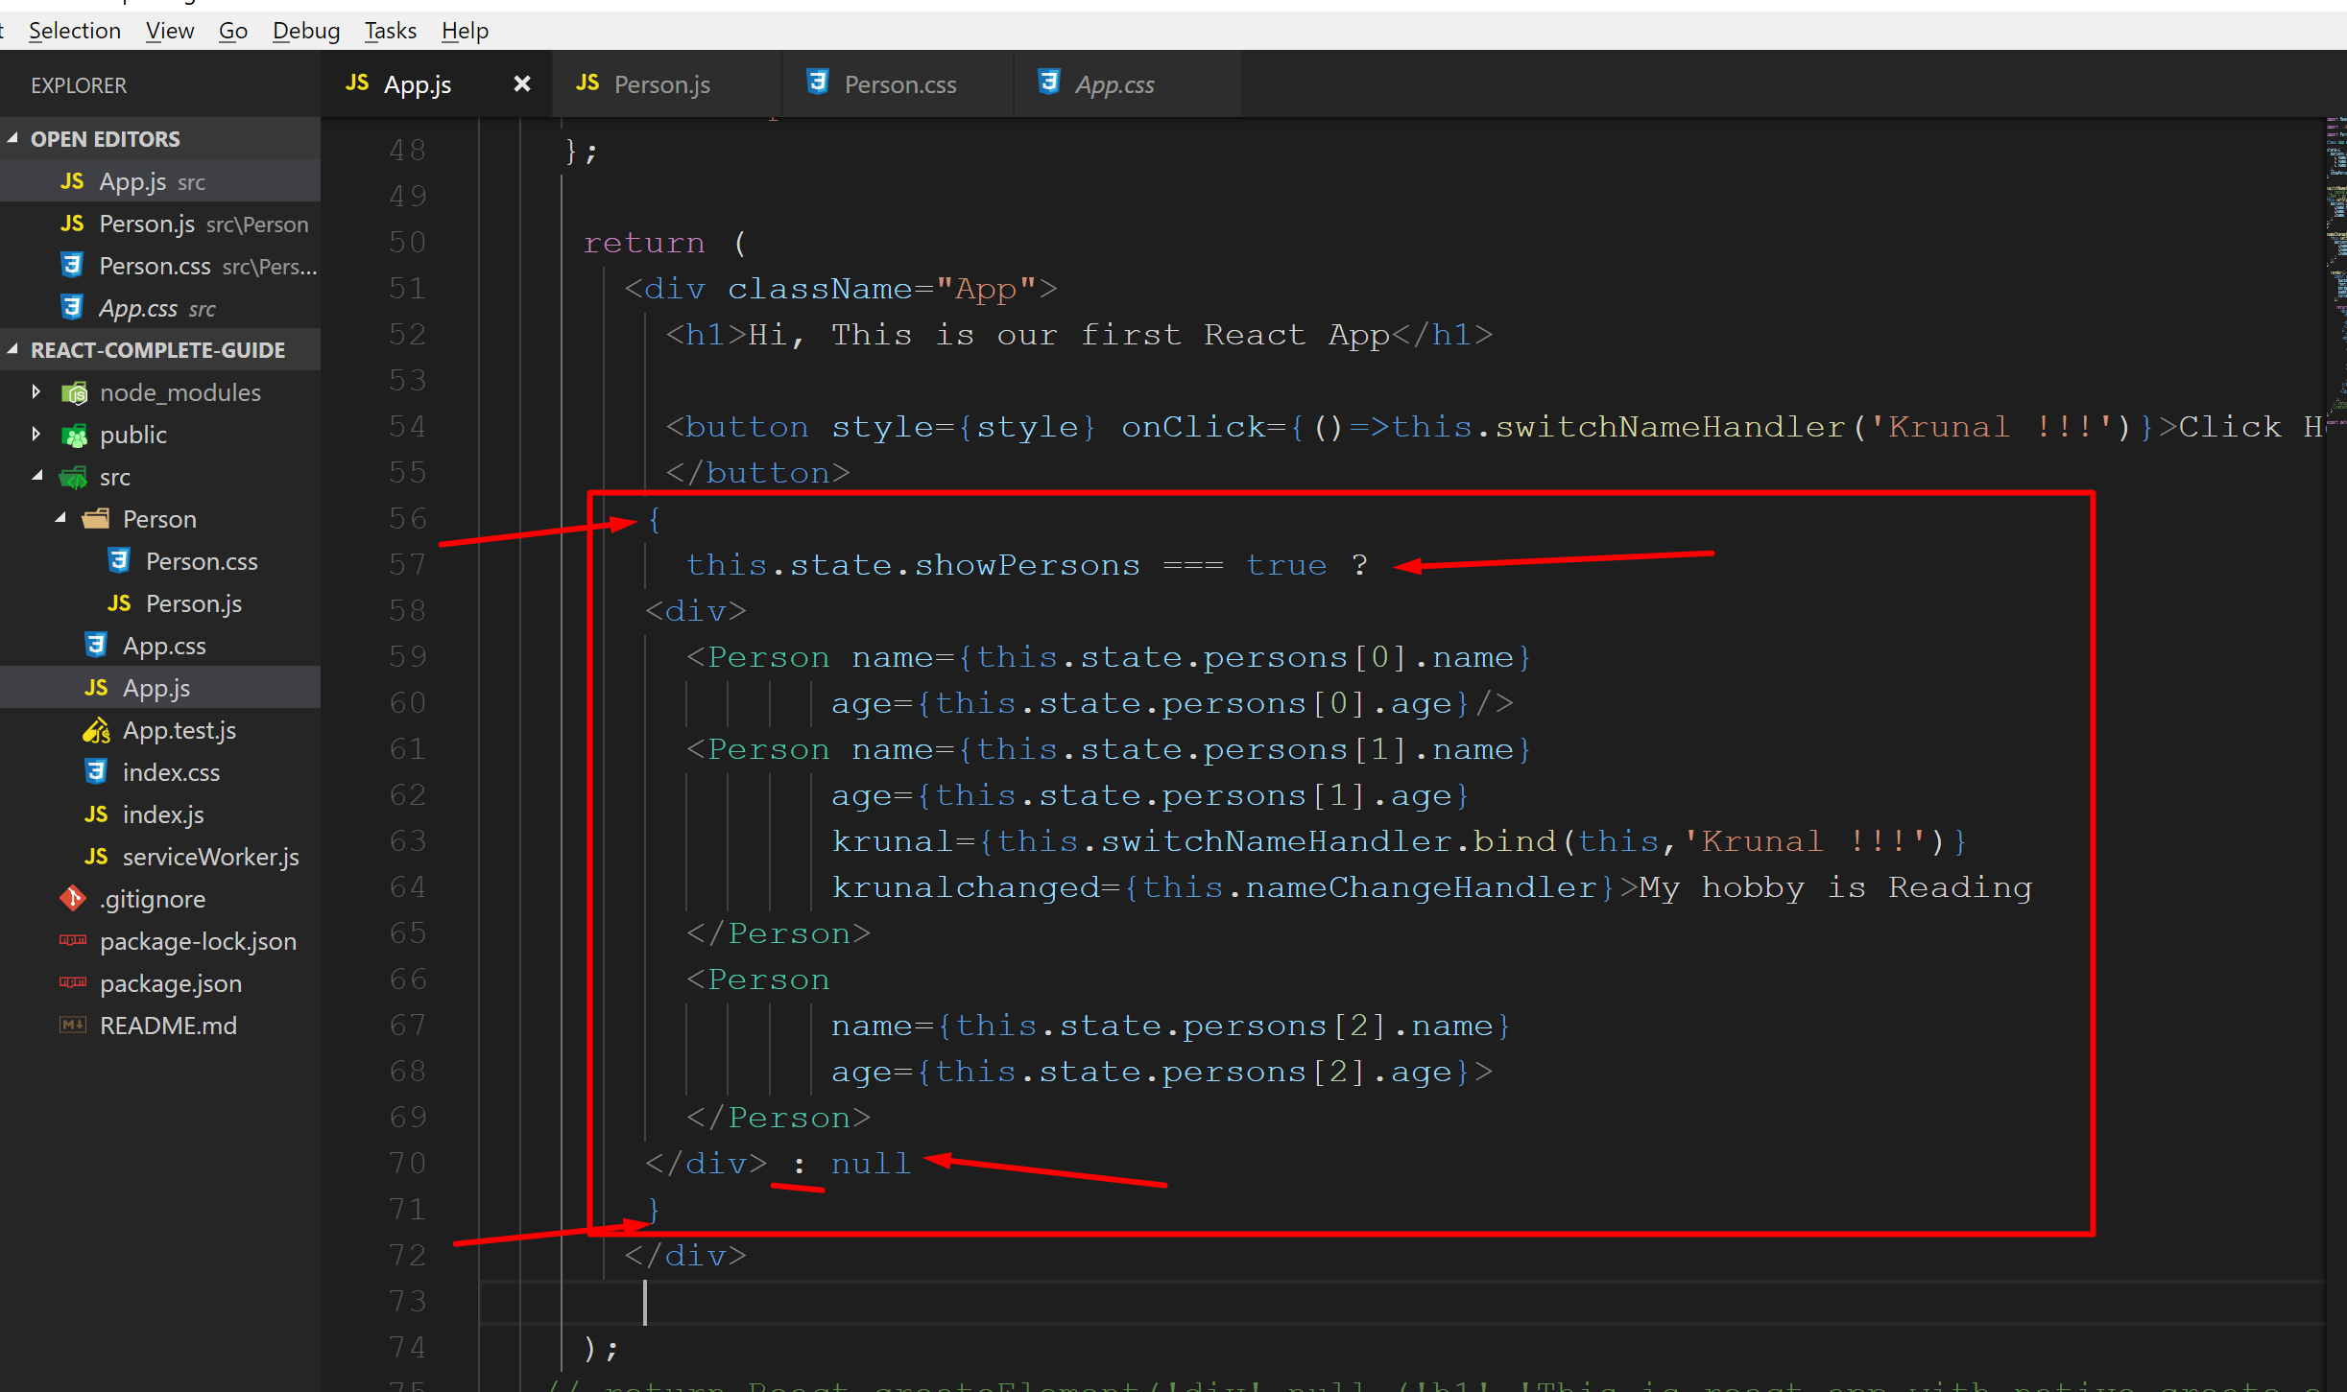
Modify the code as shown below. We wrap Person entries within a div and entire div as a JS block using {} and check Boolean's of showPersons

Slide 9
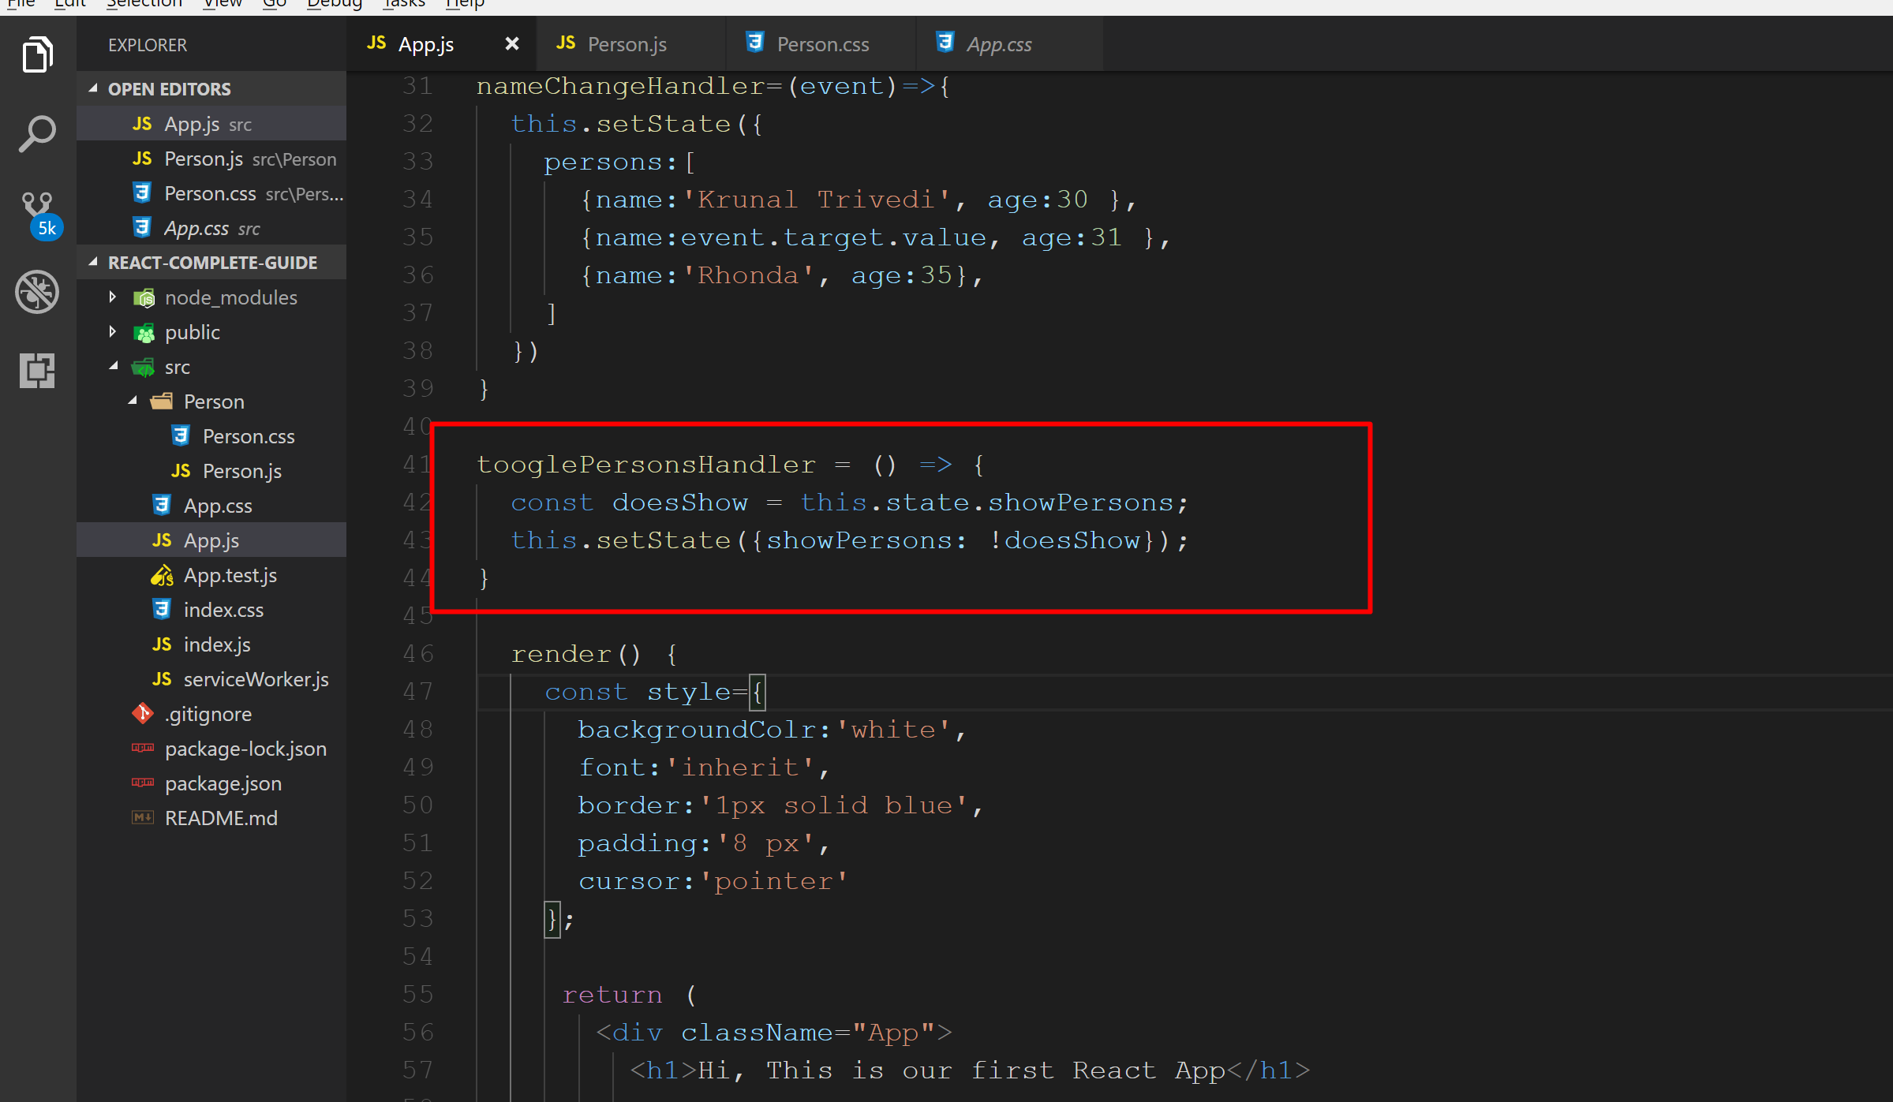
Prepare a new function tooglePersonsHandler()

Slide 10
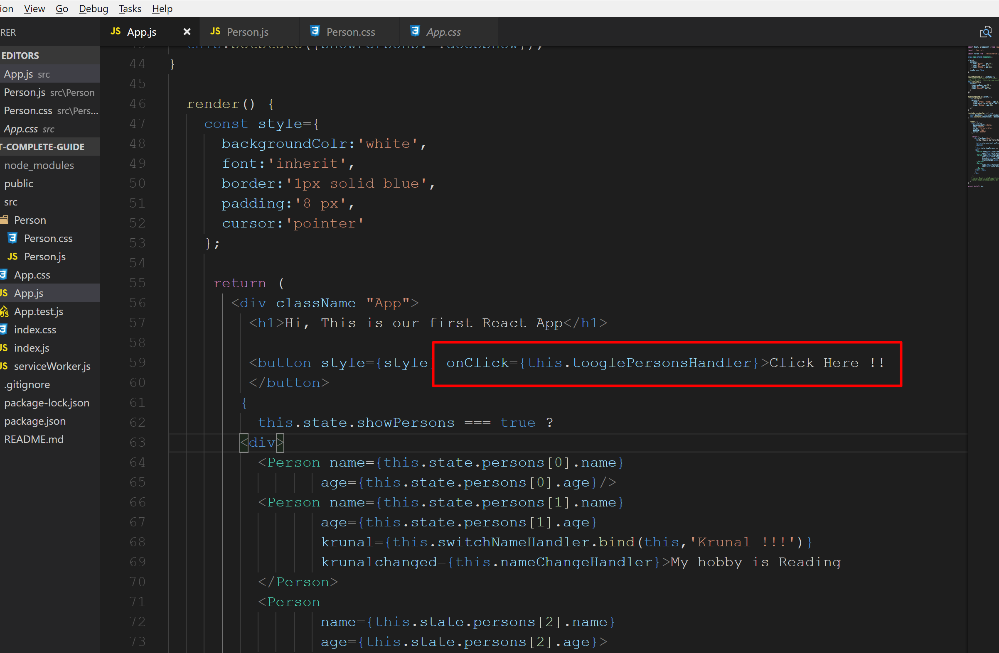
Modify the button click to this.tooglePersonsHandler

Slide 11
Previous code block make our jsx bit complex so now let us see another alternative.

Slide 12
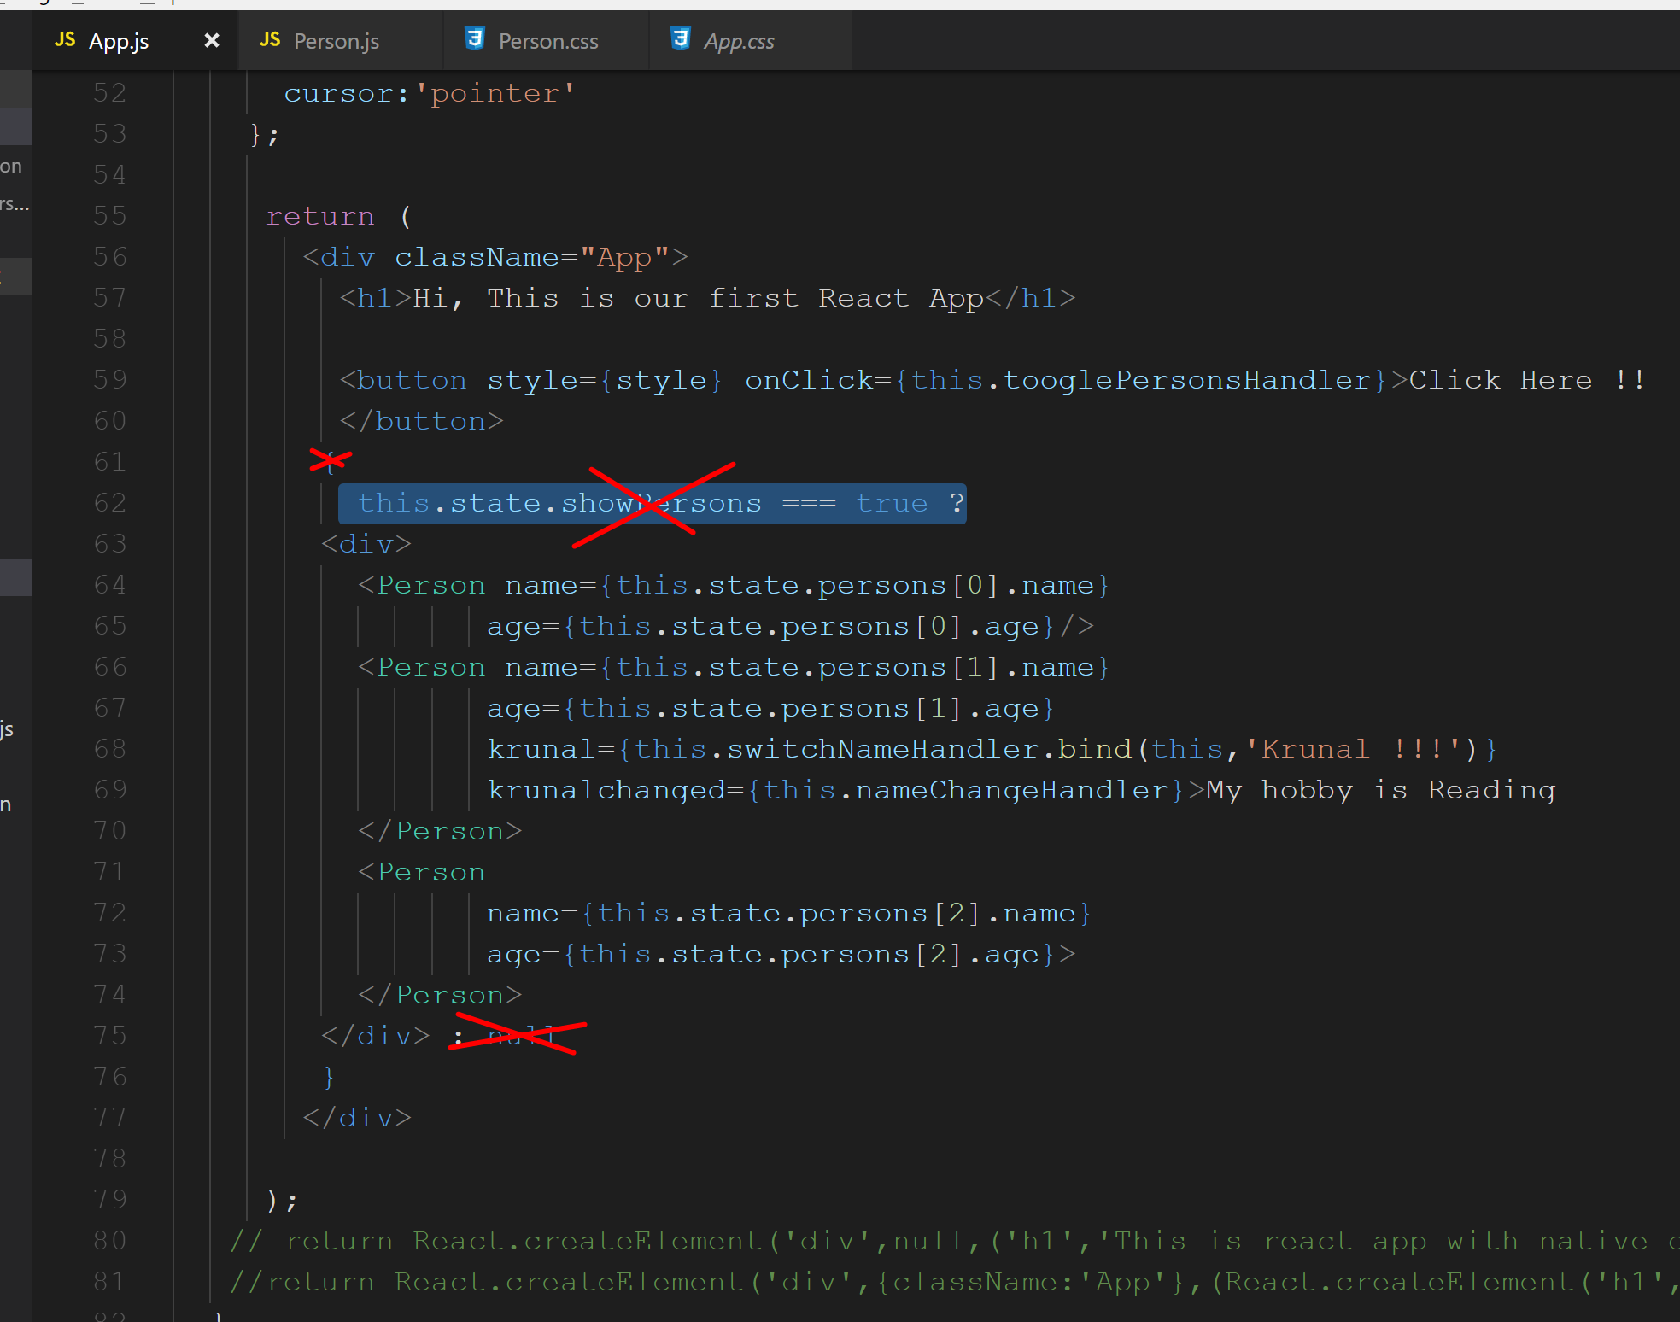
Again we undo the changes we made such as {} and this.state.showPersons===true and : null

Slide 13
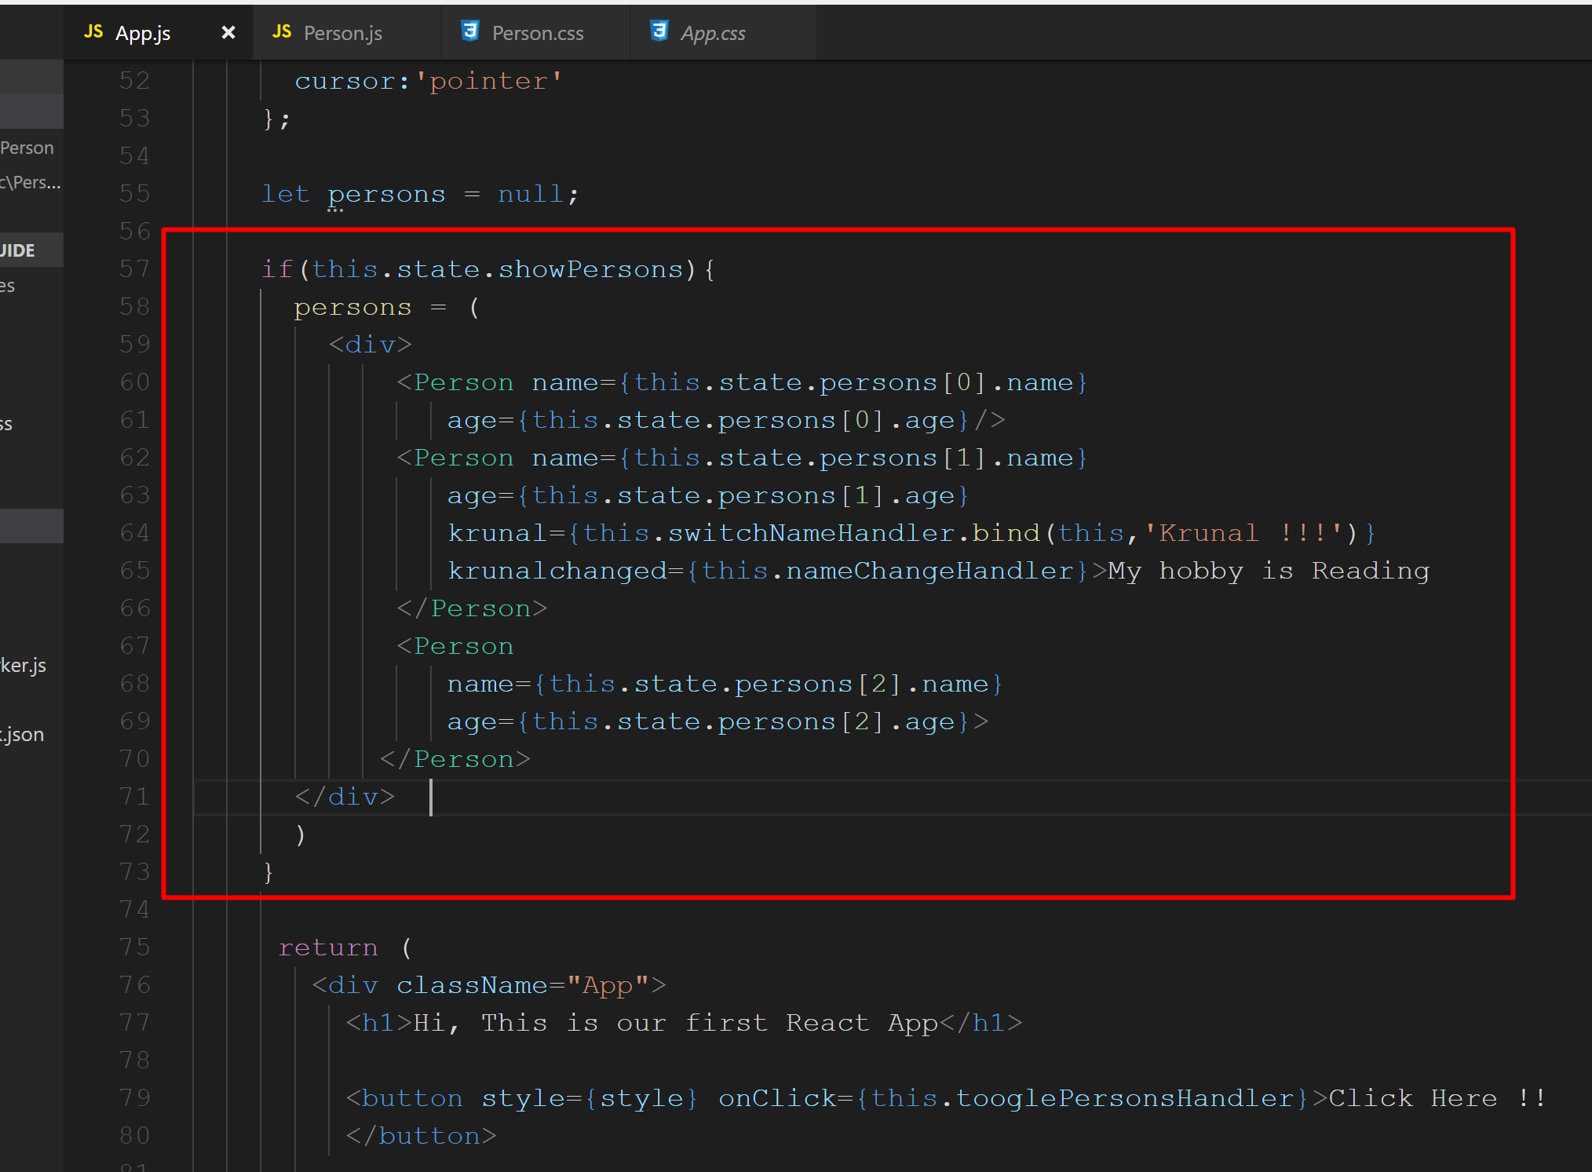
Outside the return function prepare a code block as shown below. It is the simple JavaScript and not the jsx.

Slide 14
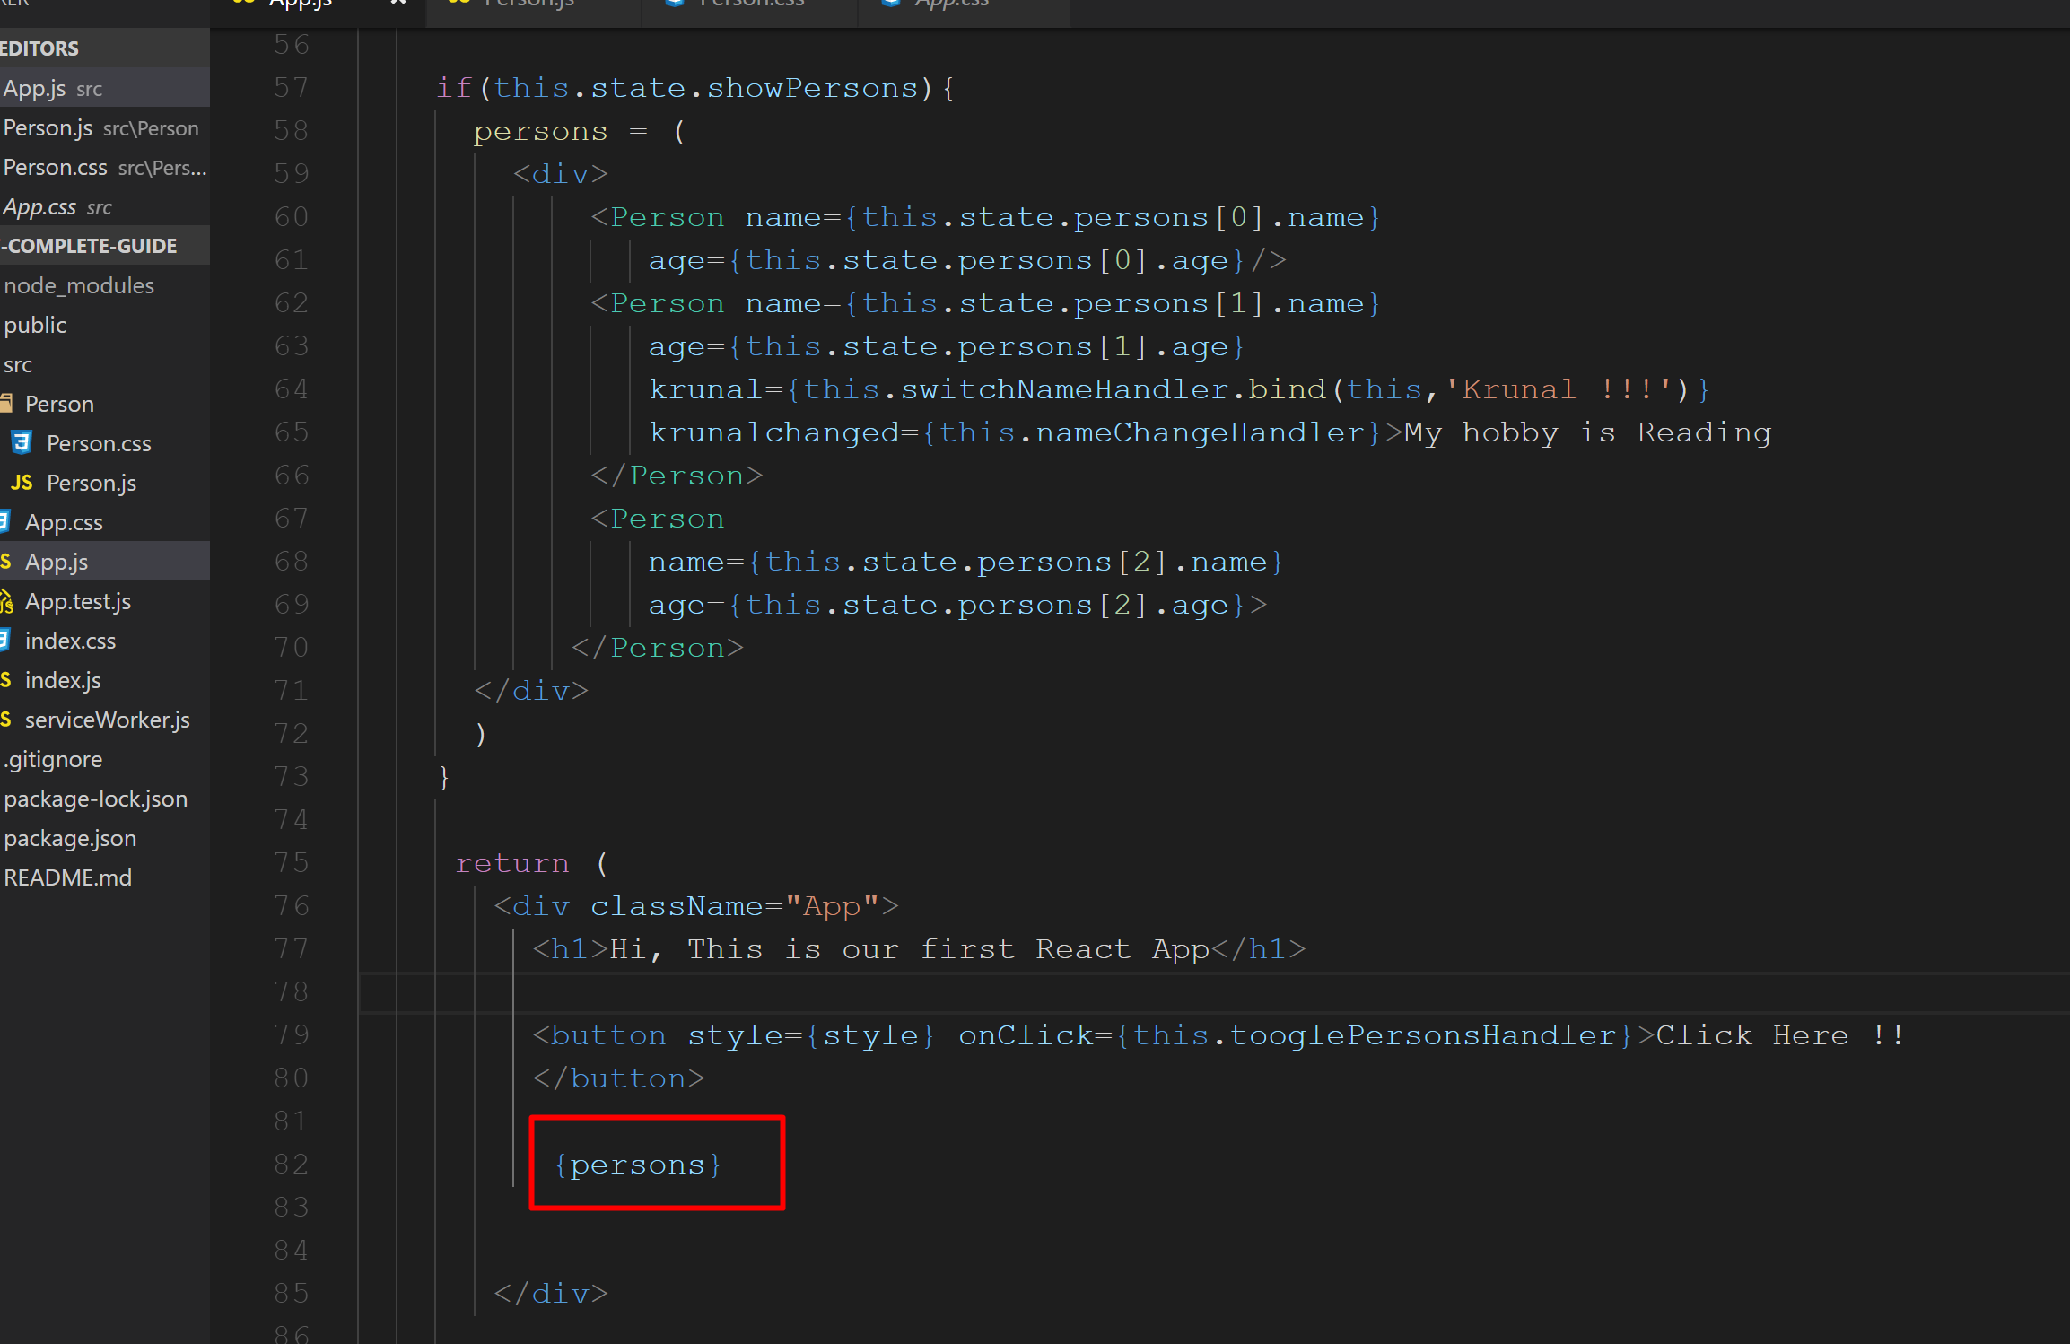
Read the {persons} variable as shown below

Slide 15
Run application and check output.

Slide 16
Outputting Lists
As we know we have an array but we are hard-coding each element of an array.

Slide 17
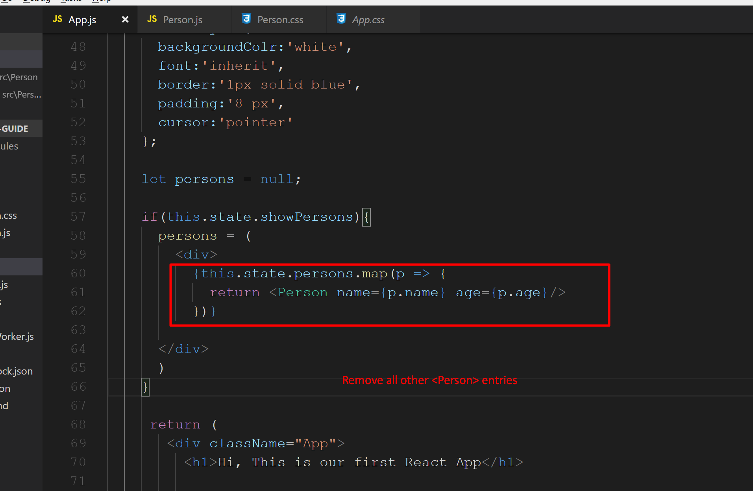
Modify code block as shown here. We have used map() function.

Slide 18
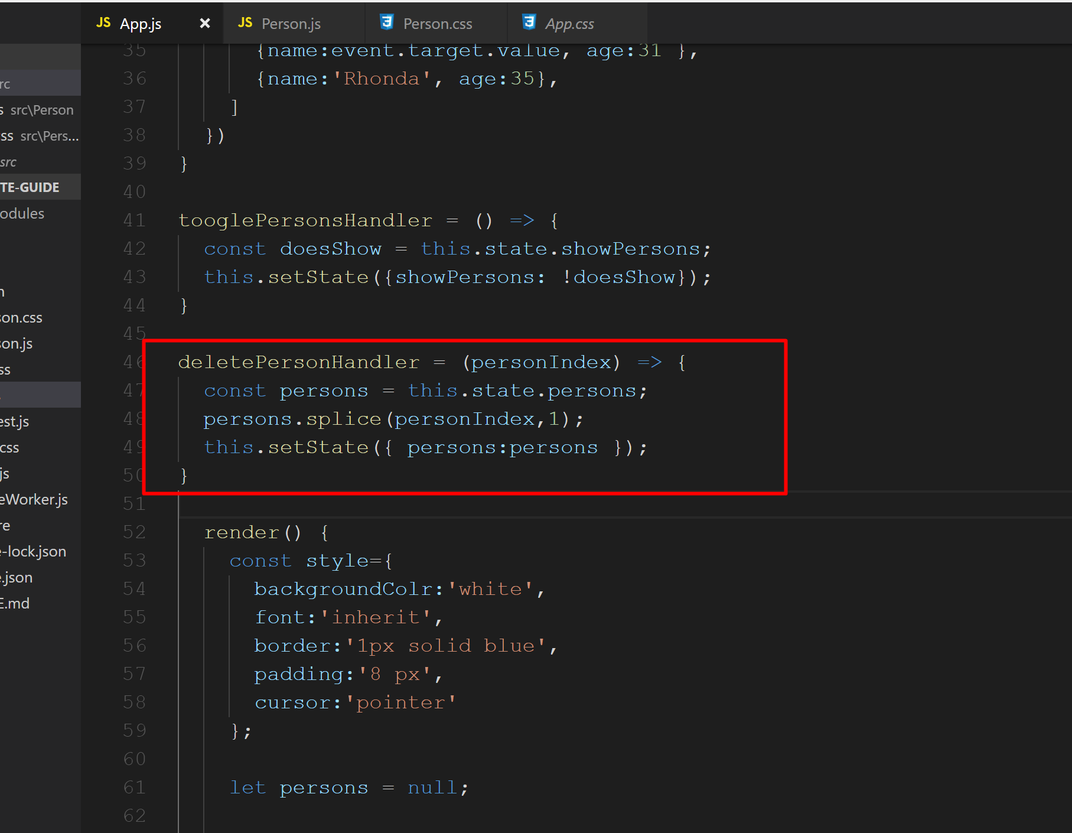
Create a new function as shown.

Slide 19
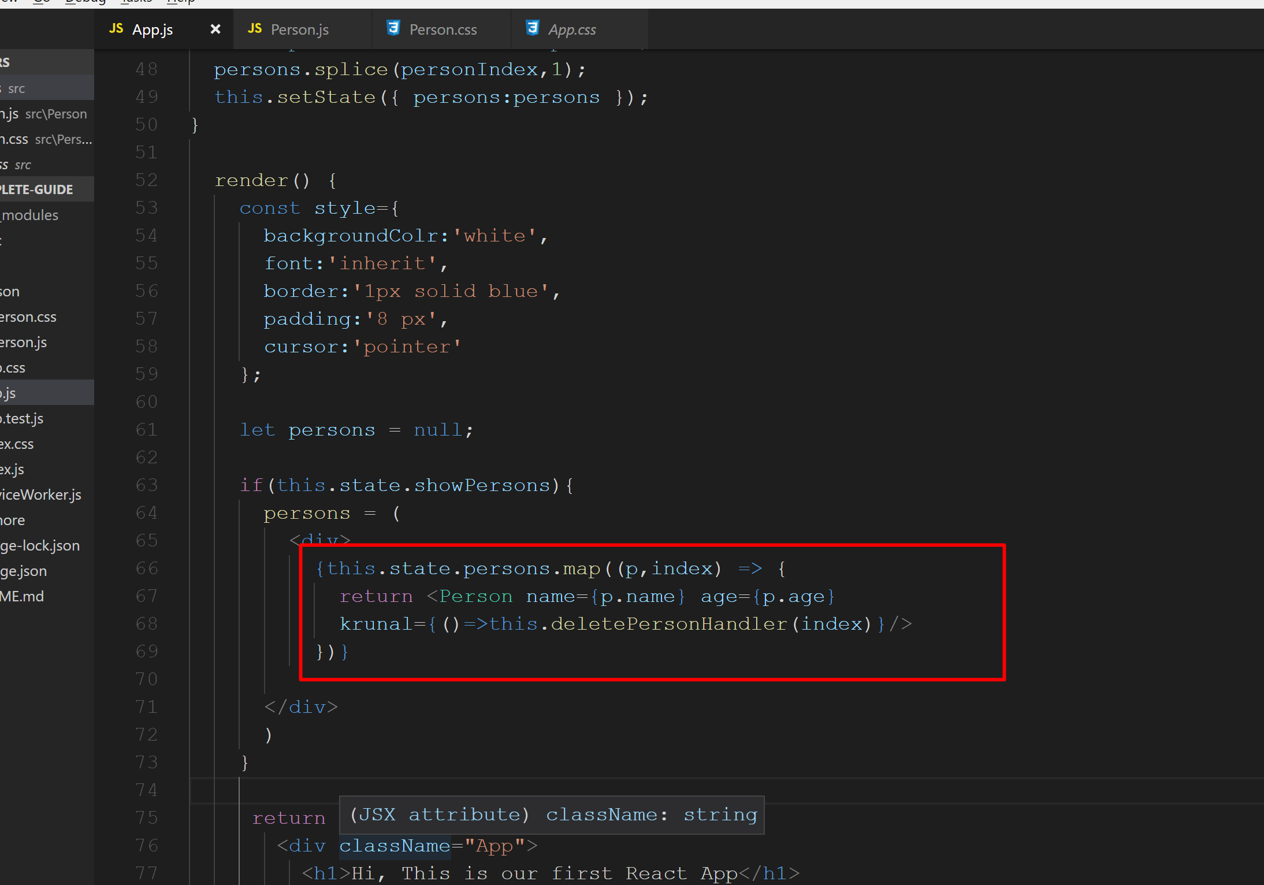
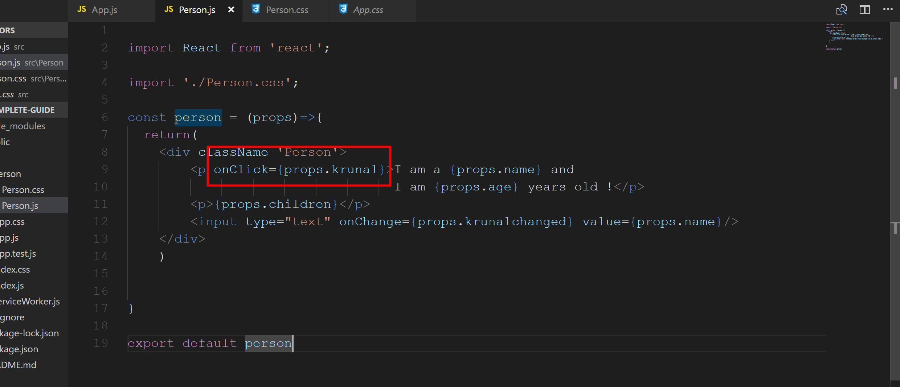
Modify the code block as shown below…
Can you guess what is krunal here???
It is a props we set in the Person.js class.

Slide 20
Run application check output.
Still, there is one flaw in this code.

Slide 21
So, now we will update state immutably.

Slide 22
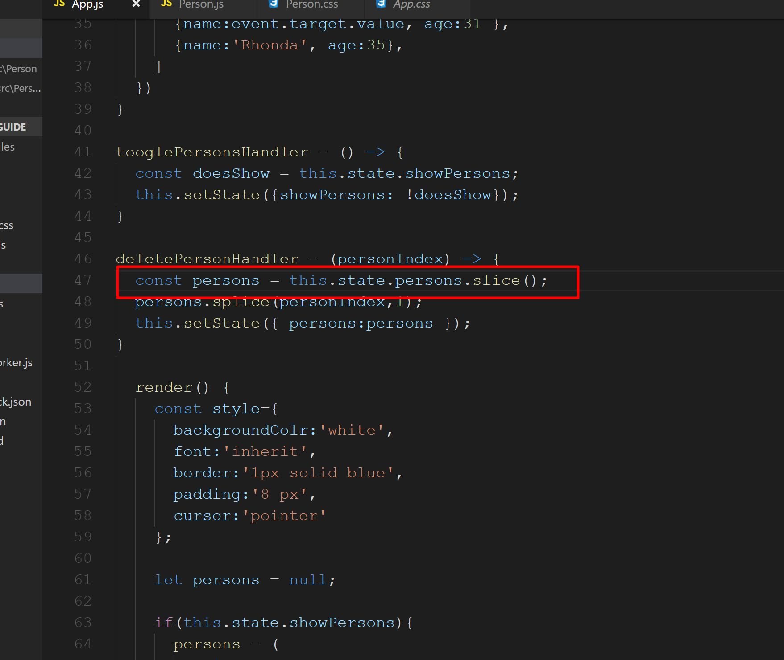
Flaw with the previous code was array is a reference type so we should use slice() method which will make a new copy of the array.

Slide 23
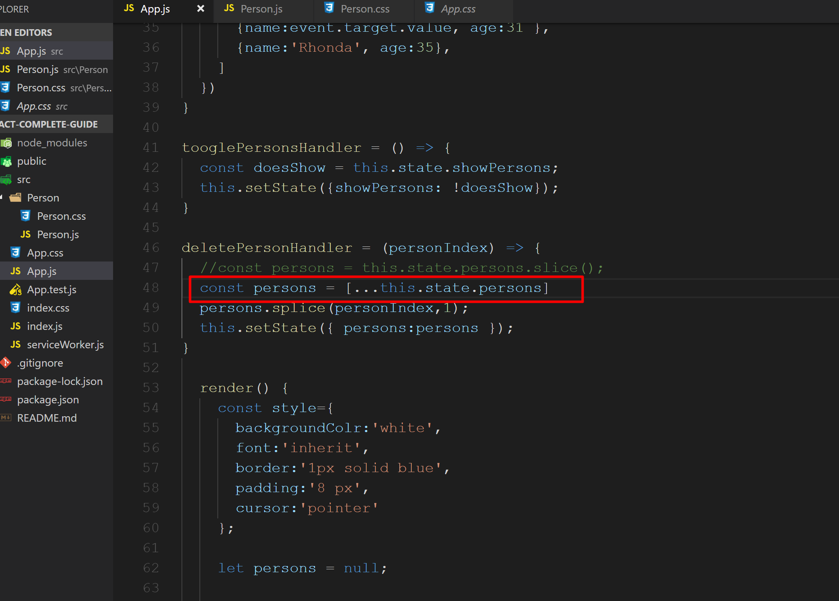
In ES 6, we have spread operator …

Slide 24
We should always update the state in immutable way.
Without changing the state of the original element.

Slide 25
Key property is important property we should add while rendering list data.
It’s the default property which react expects to find on an element no matter if it’s a custom component or a default html element which you render through a list.
This key property helps react to update the list effectively.
This key must be unique. In generally our primary key or any unique identifier.

Slide 26
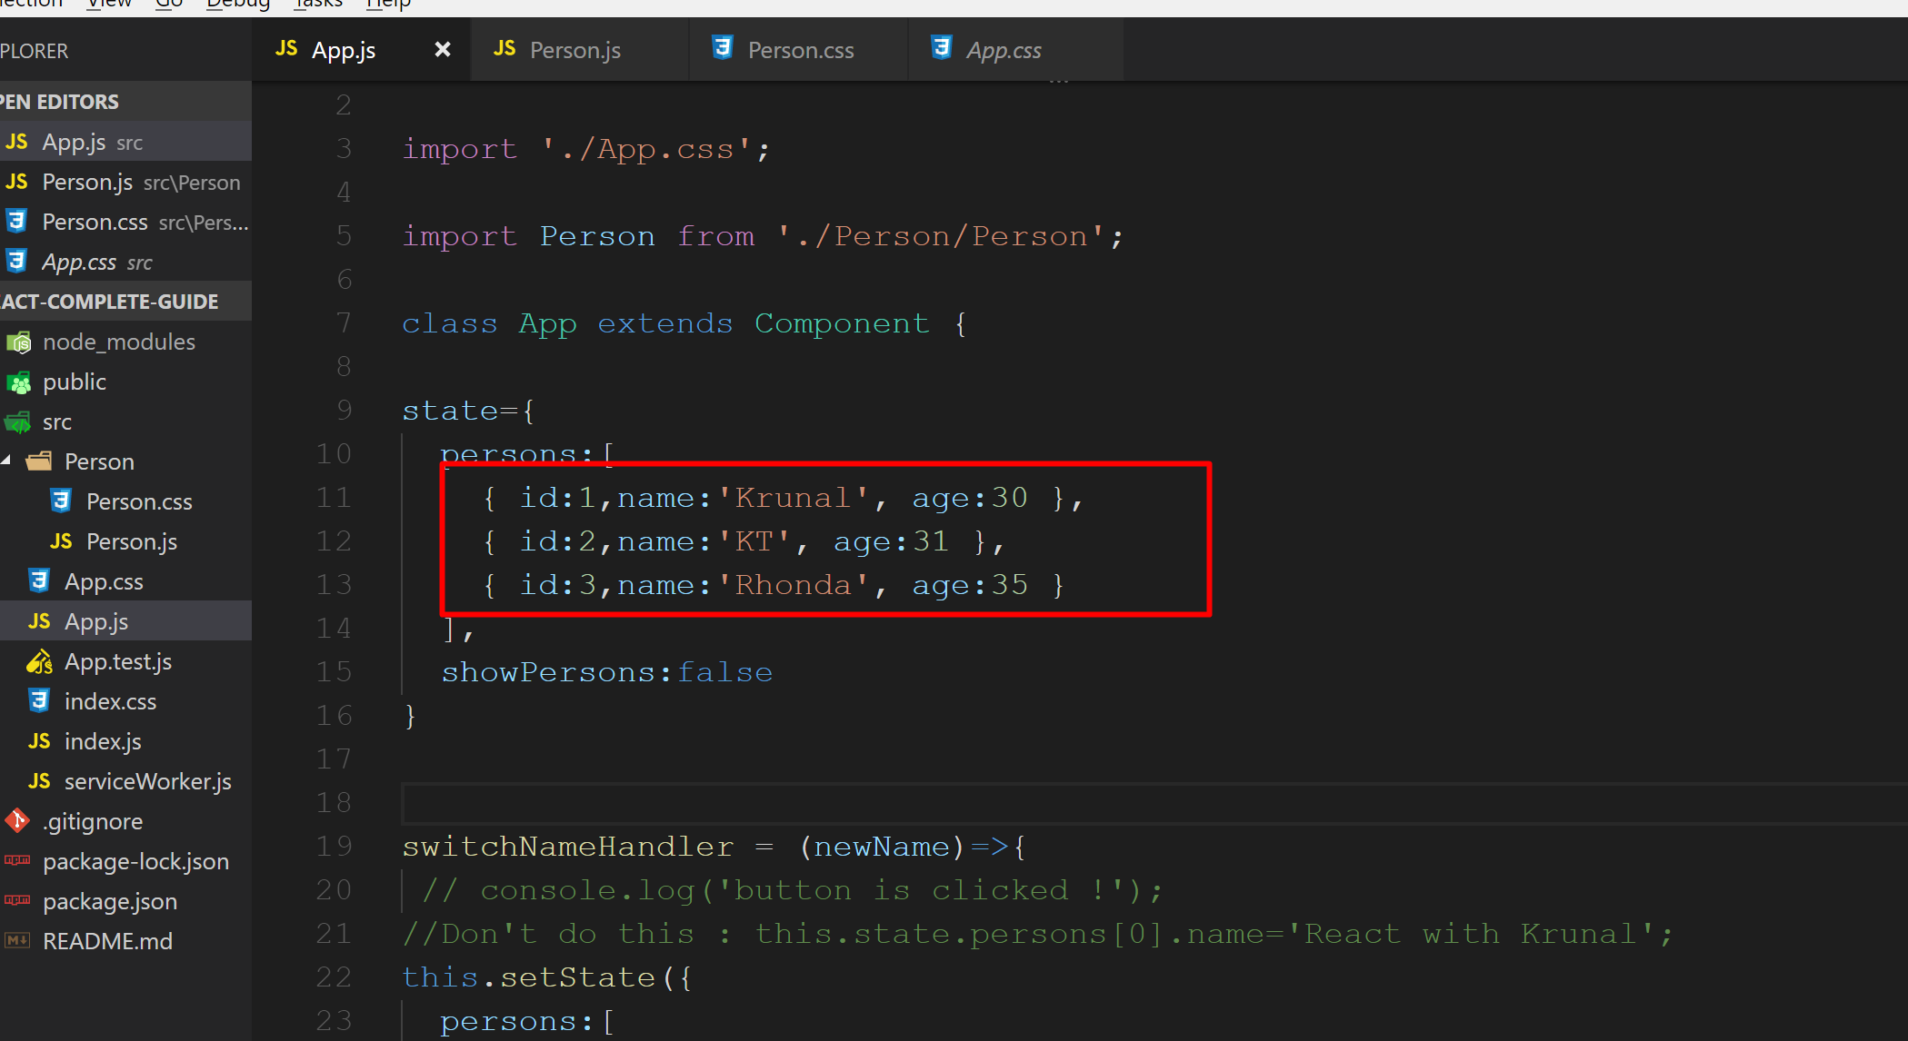
So, I add some dummy id’s here…

Slide 27
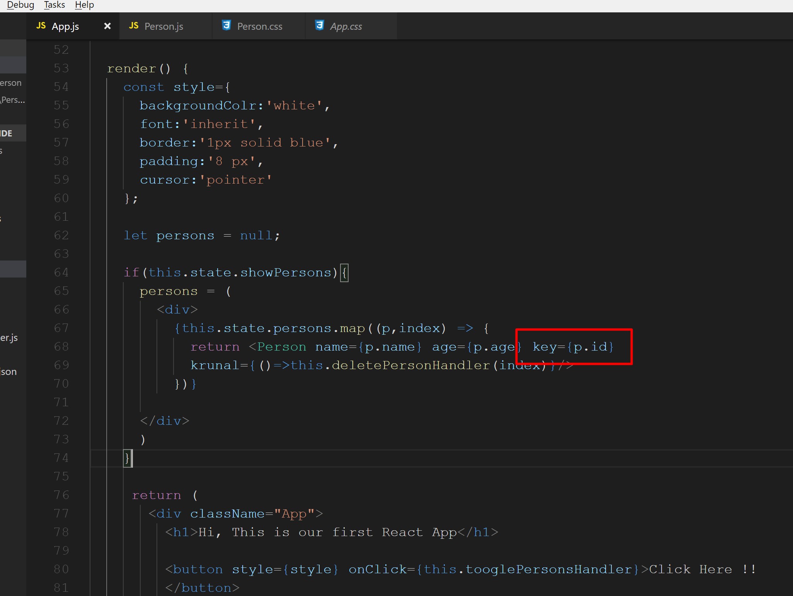
Add key property

Slide 28
Run the application and check output.

Slide 29
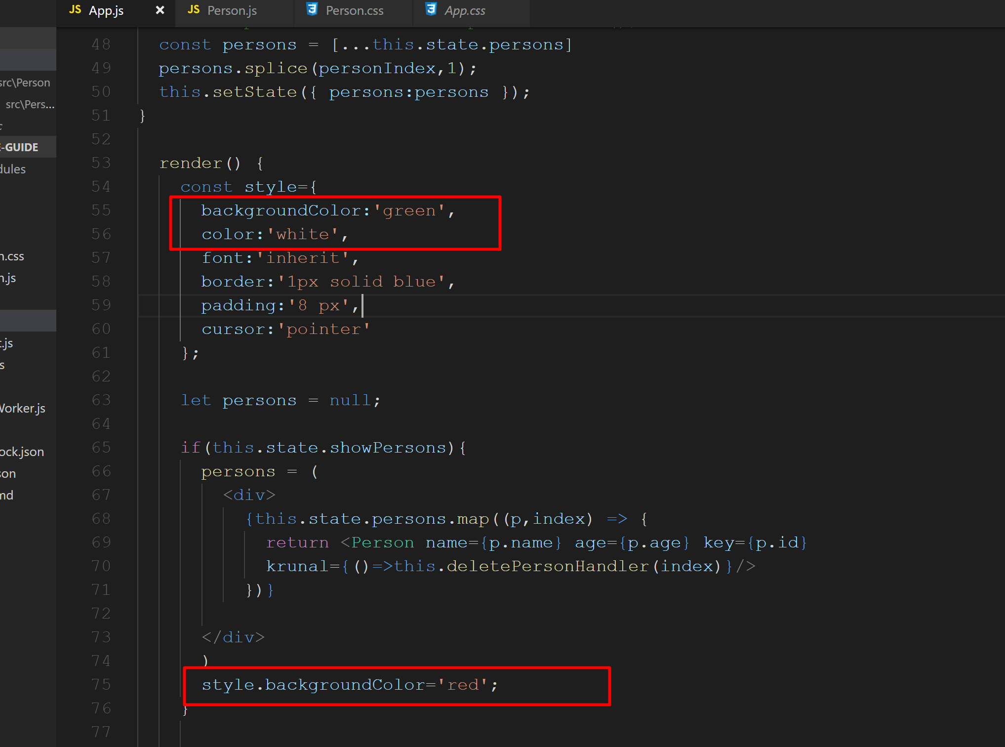
Setting styles dynamically Here we change the value of style variable and override the backgroundColor in the if block

Slide 30
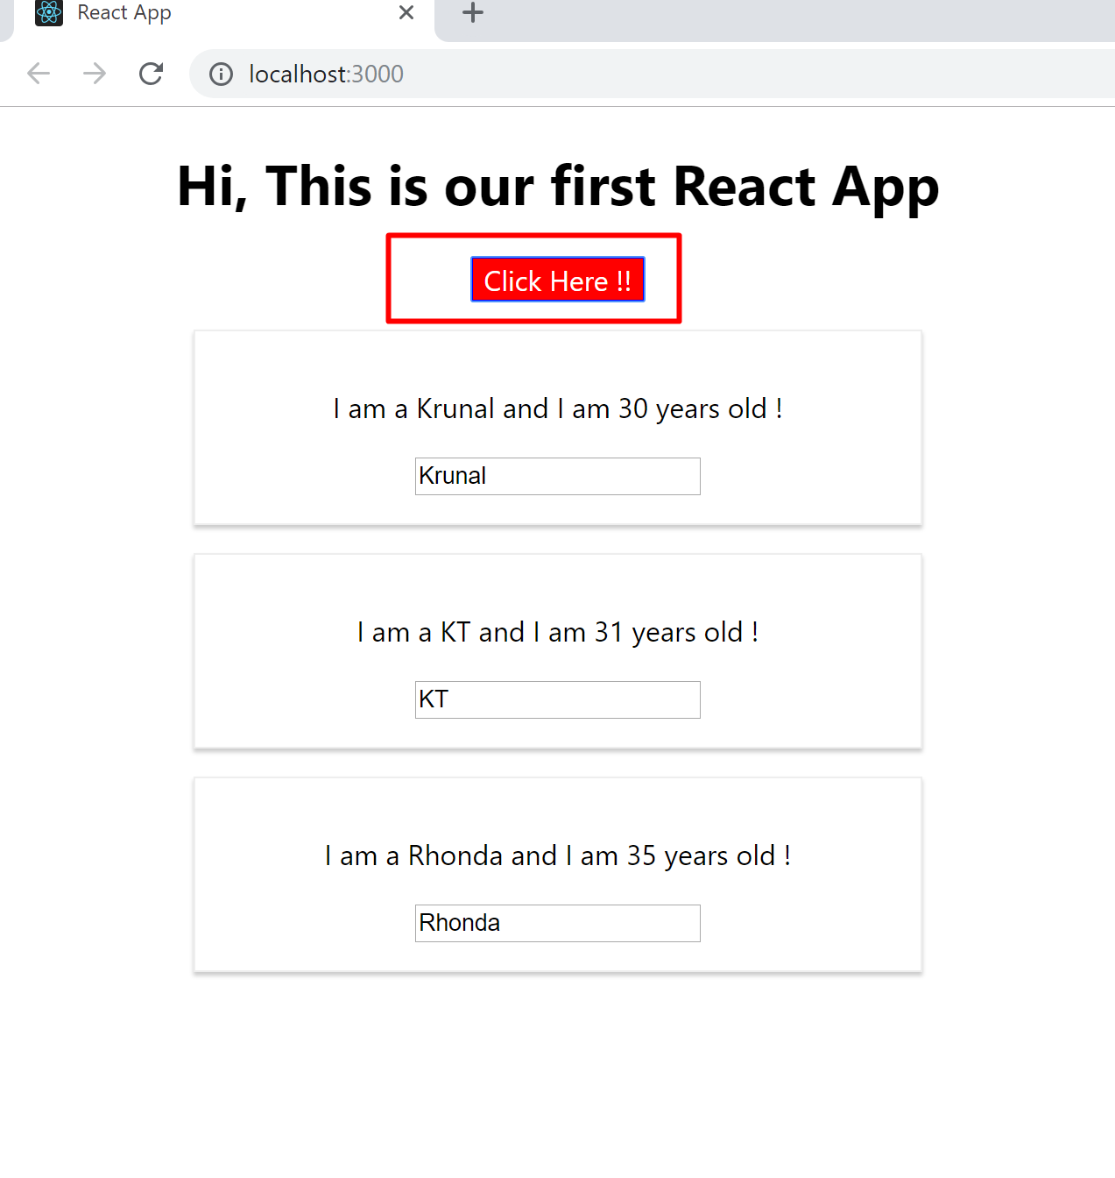
Run the application. Click on button. Check the output.

Slide 31
Setting Class Names Dynamically

Slide 32
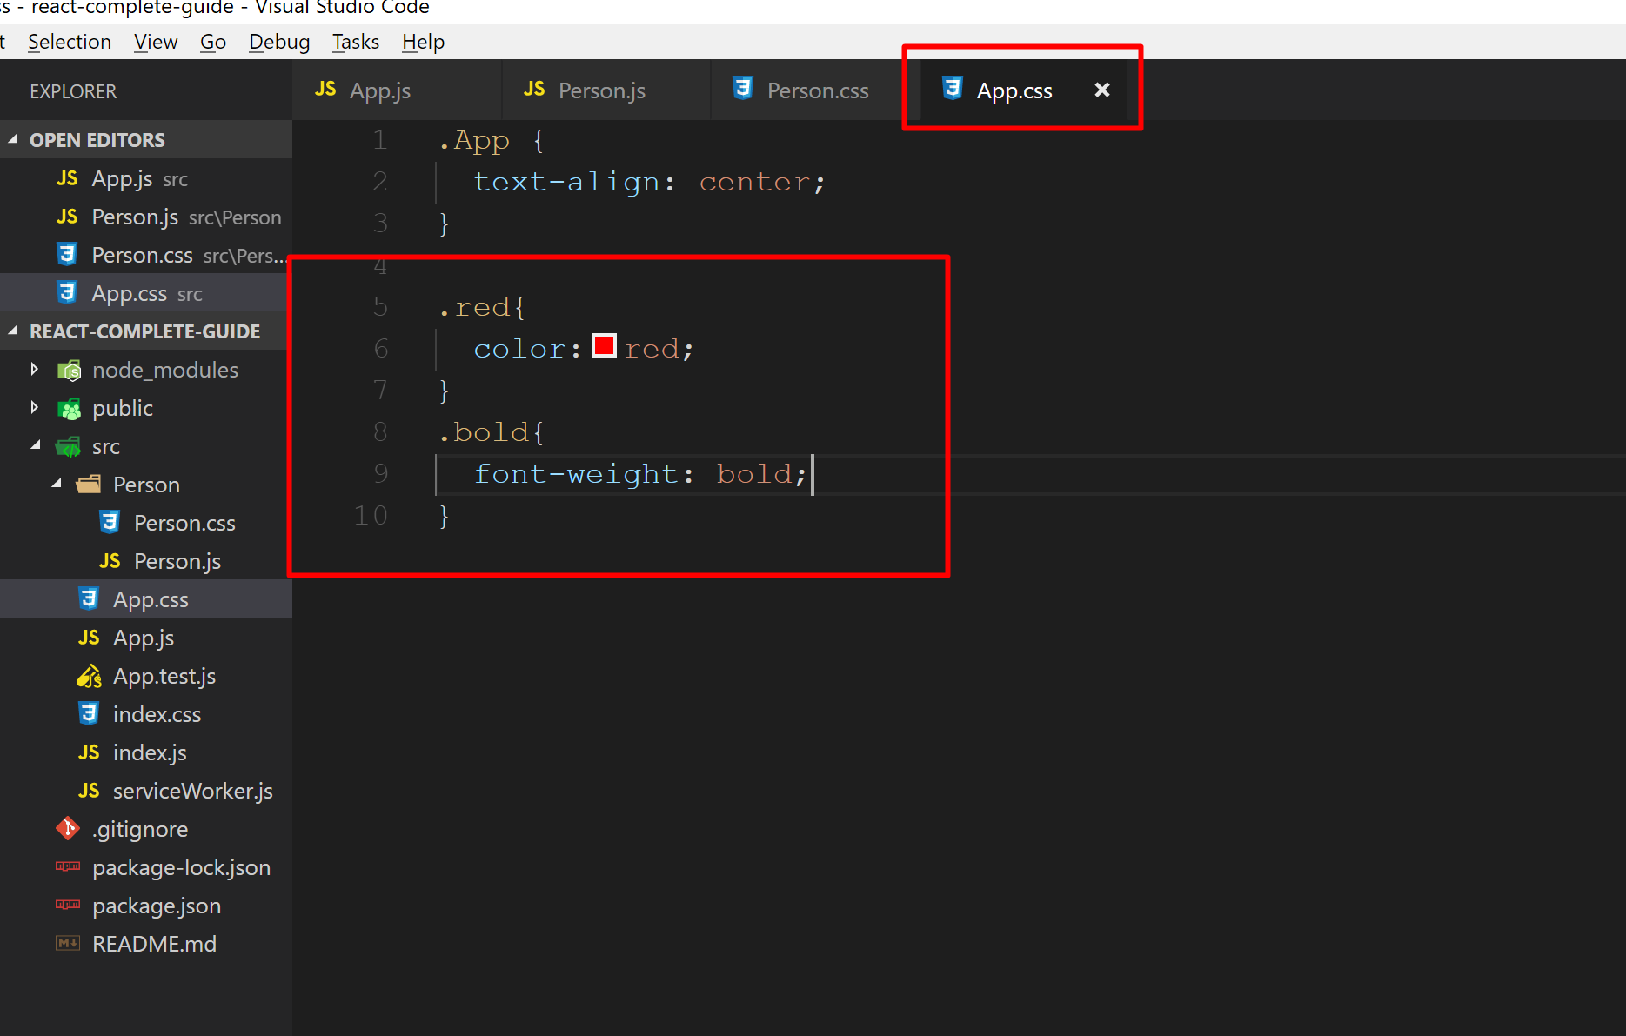
Open App.css and prepare two new classes…

Slide 33
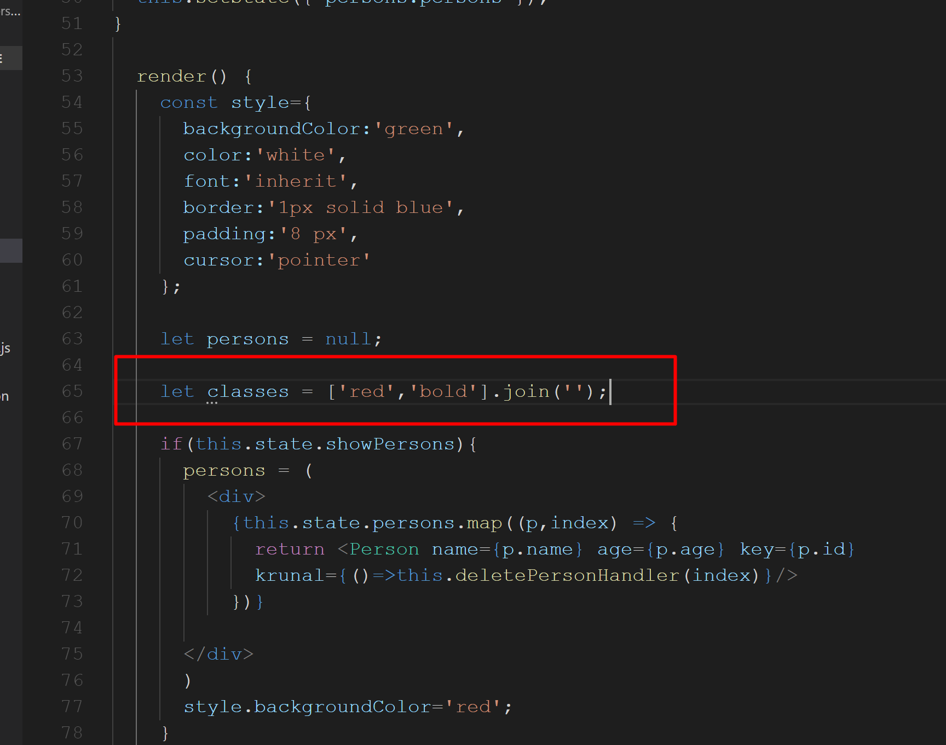
Create a variable. Here I have passs class names as an array element without . and used join with an empty space. So it will return a simple string of class names.

Slide 34
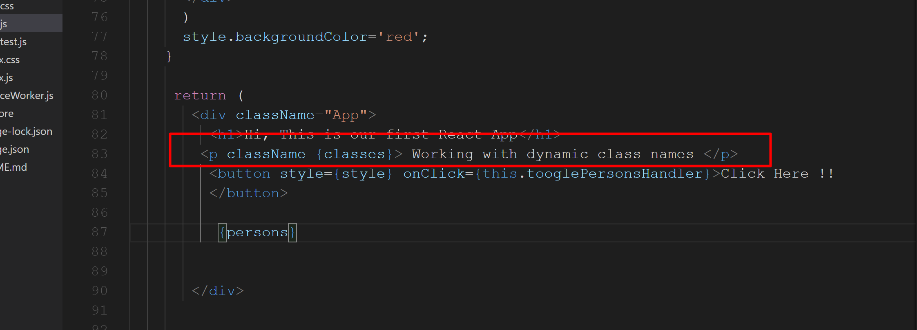
Create a new Paragraph and apply className={classes}

Slide 35
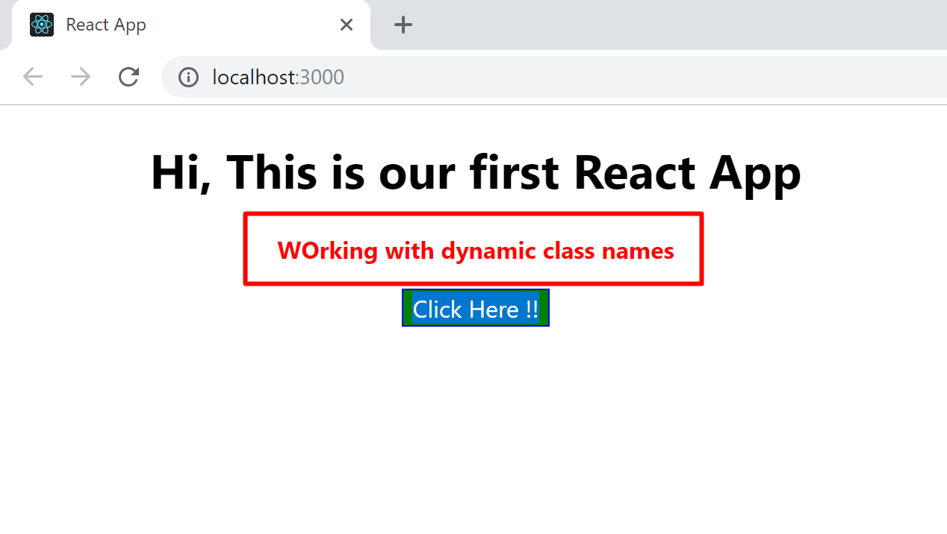
Check the output.

Slide 36
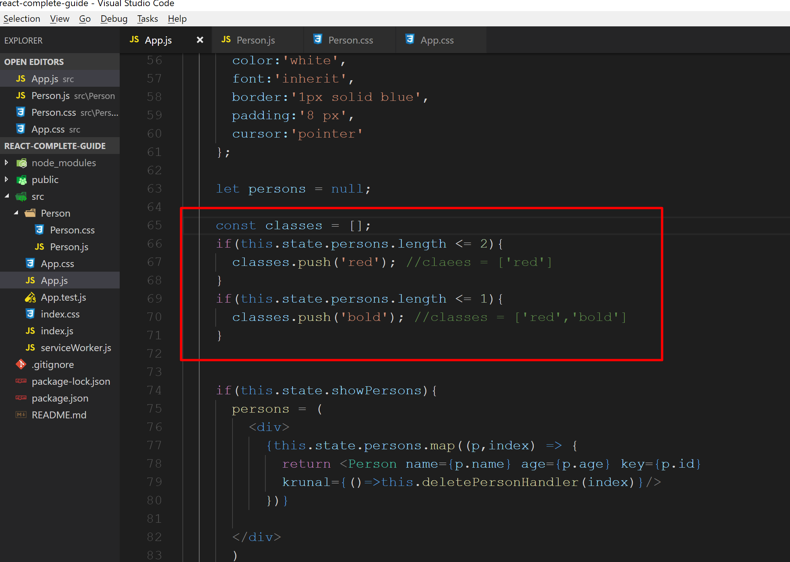
Modify the classes variable here.

Slide 37
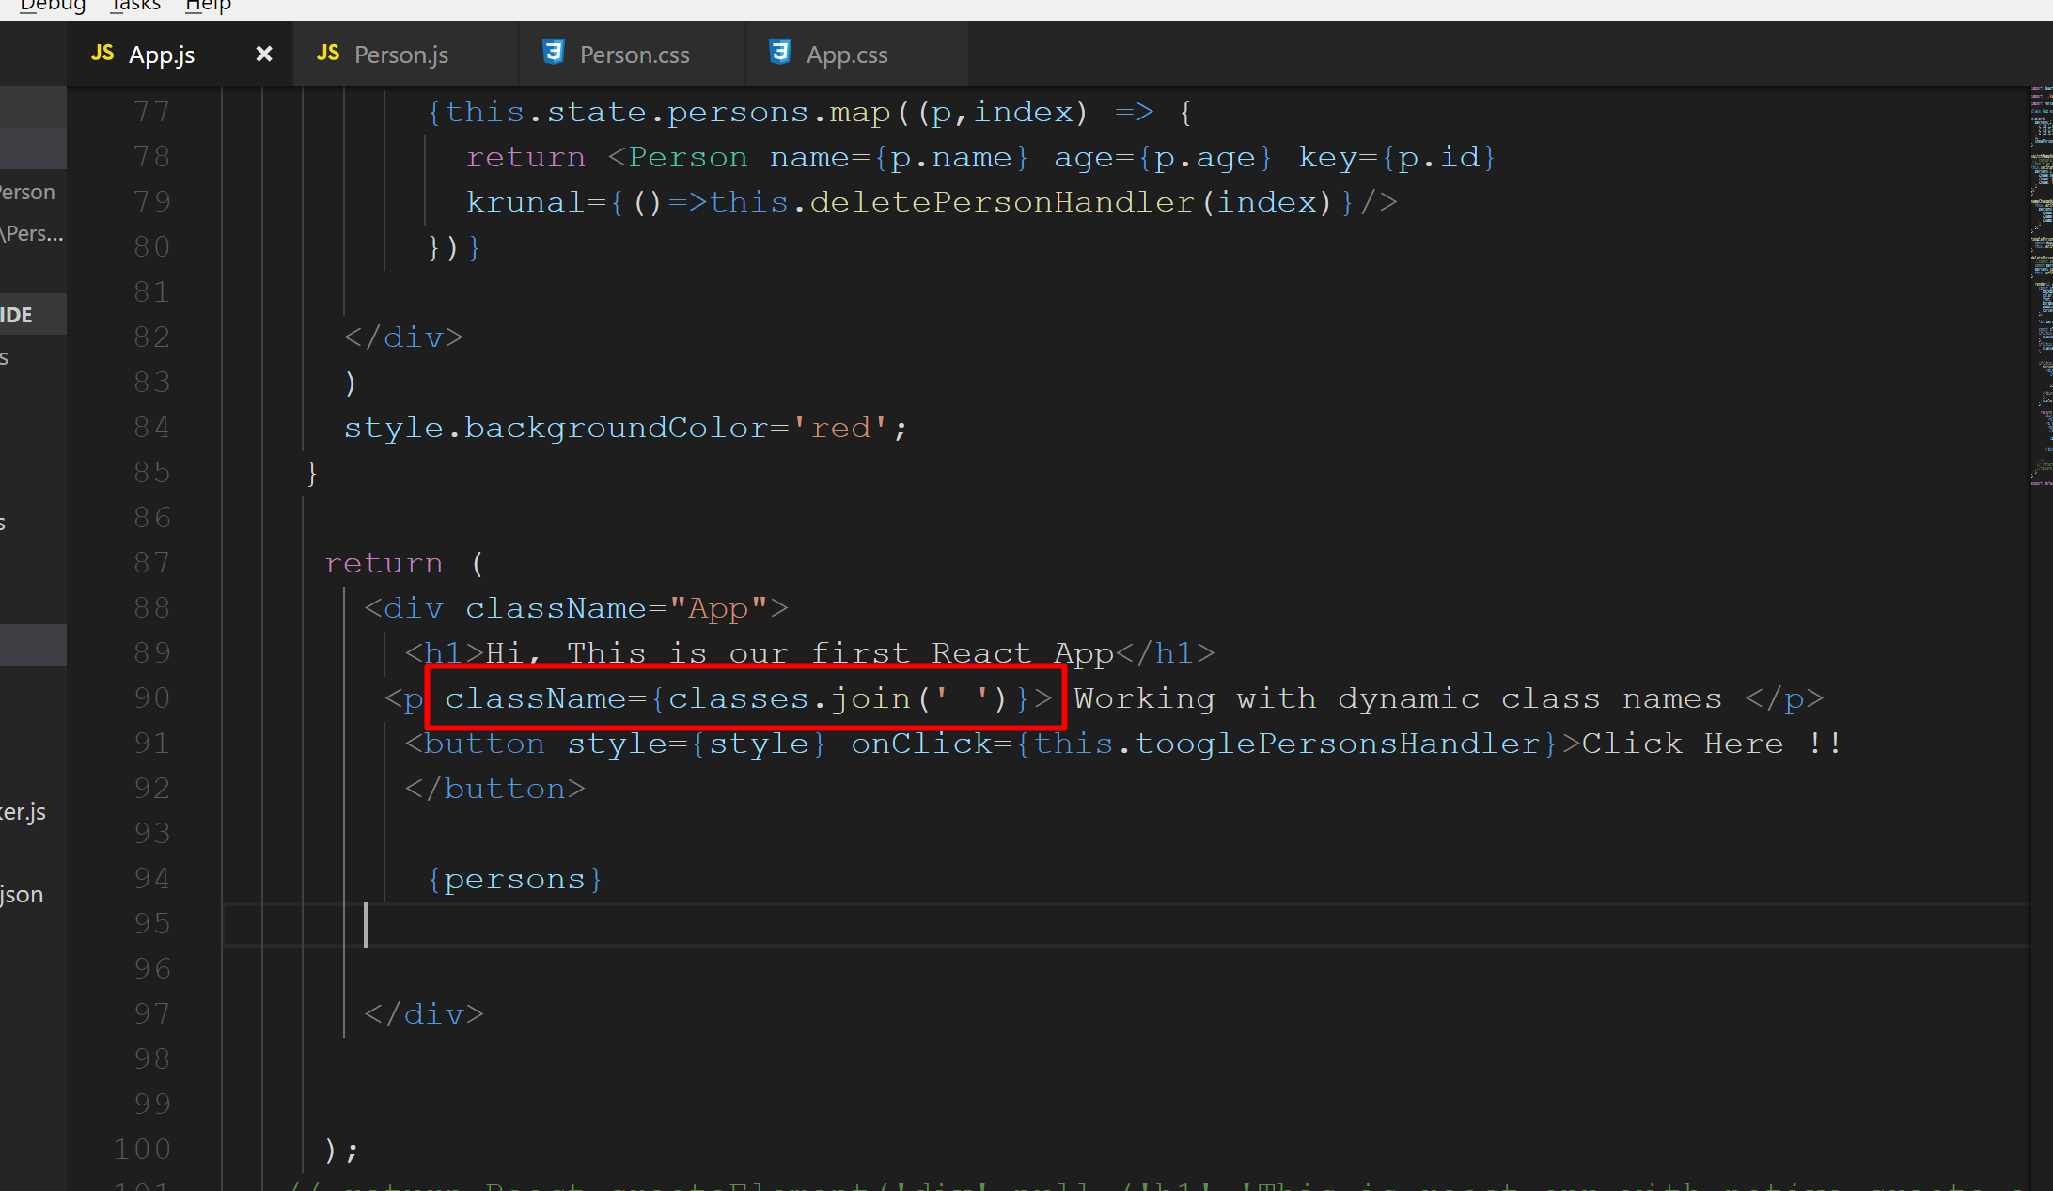
Modify the className attribute for the <p>

Slide 38
Run the application and check the output.

Slide 39
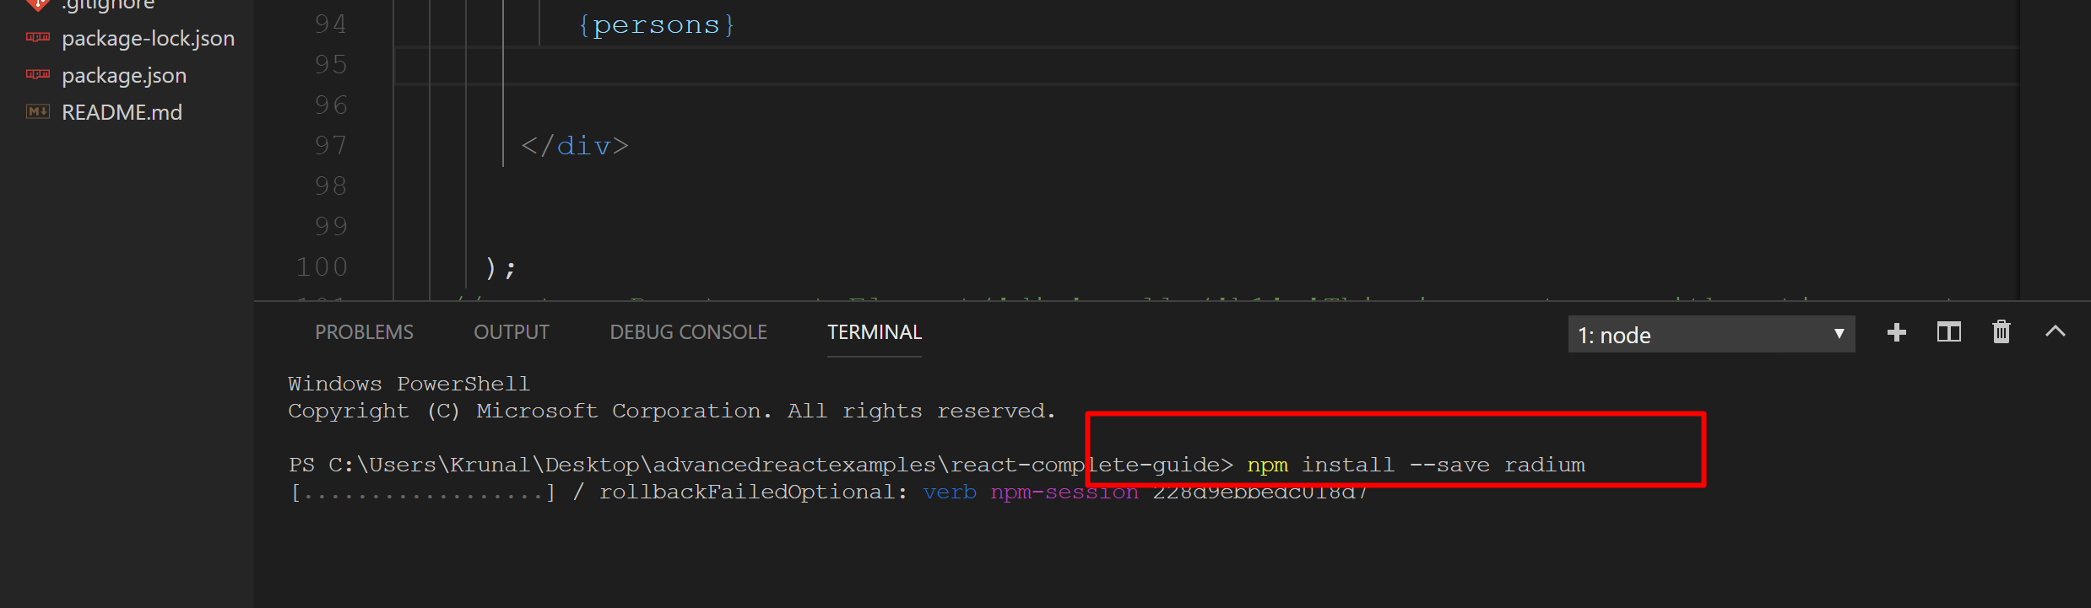
install radium to your application using npm install –save radium.
Radium is the popular package for react which allows us to use inline style with pseudo selectors and media queries.
npm cache clean –force
npm install --save radium --legacy-peer-deps

Slide 40
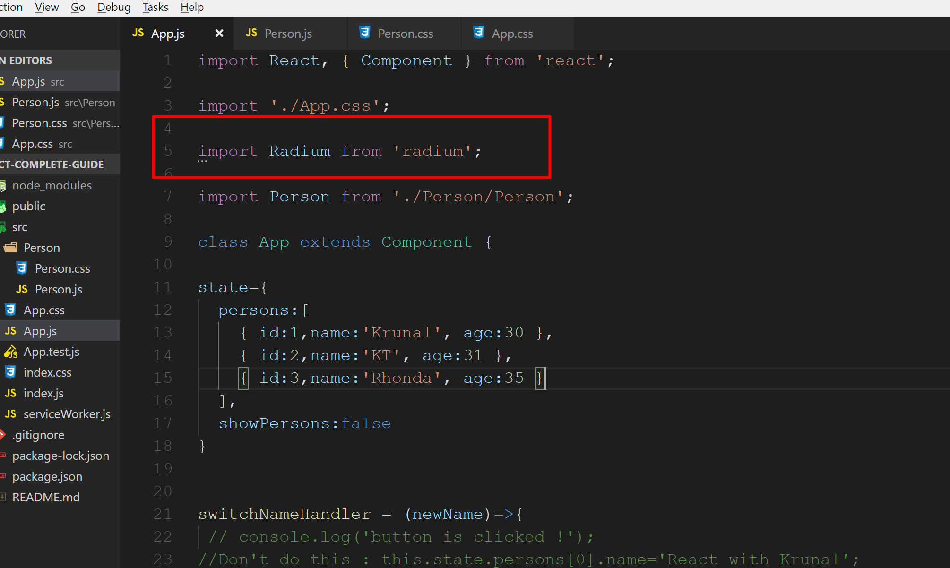
Import Radium to App.js file

Slide 41
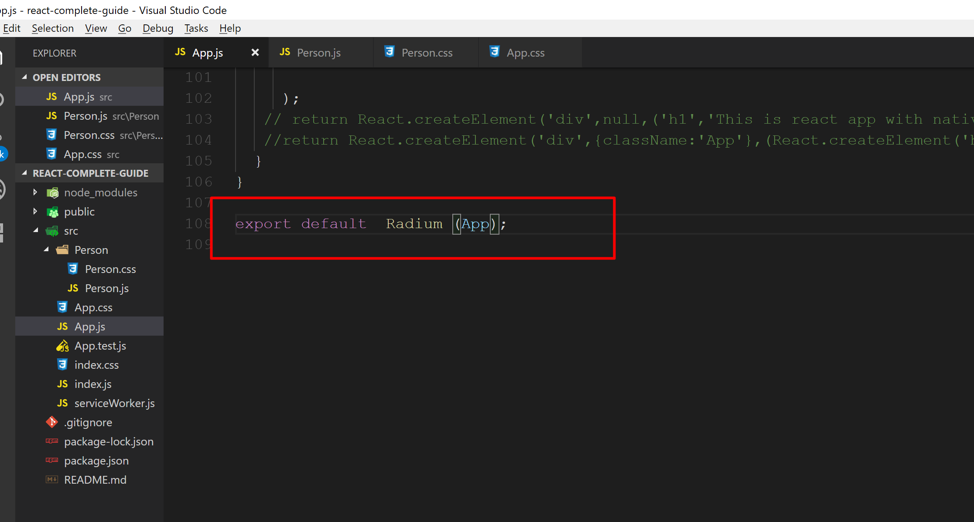
In App.js file wrap your (App) component with the Radium. This is called higher order component. It is just one component injecting some extra functionalities to the wrapped component.

Slide 42
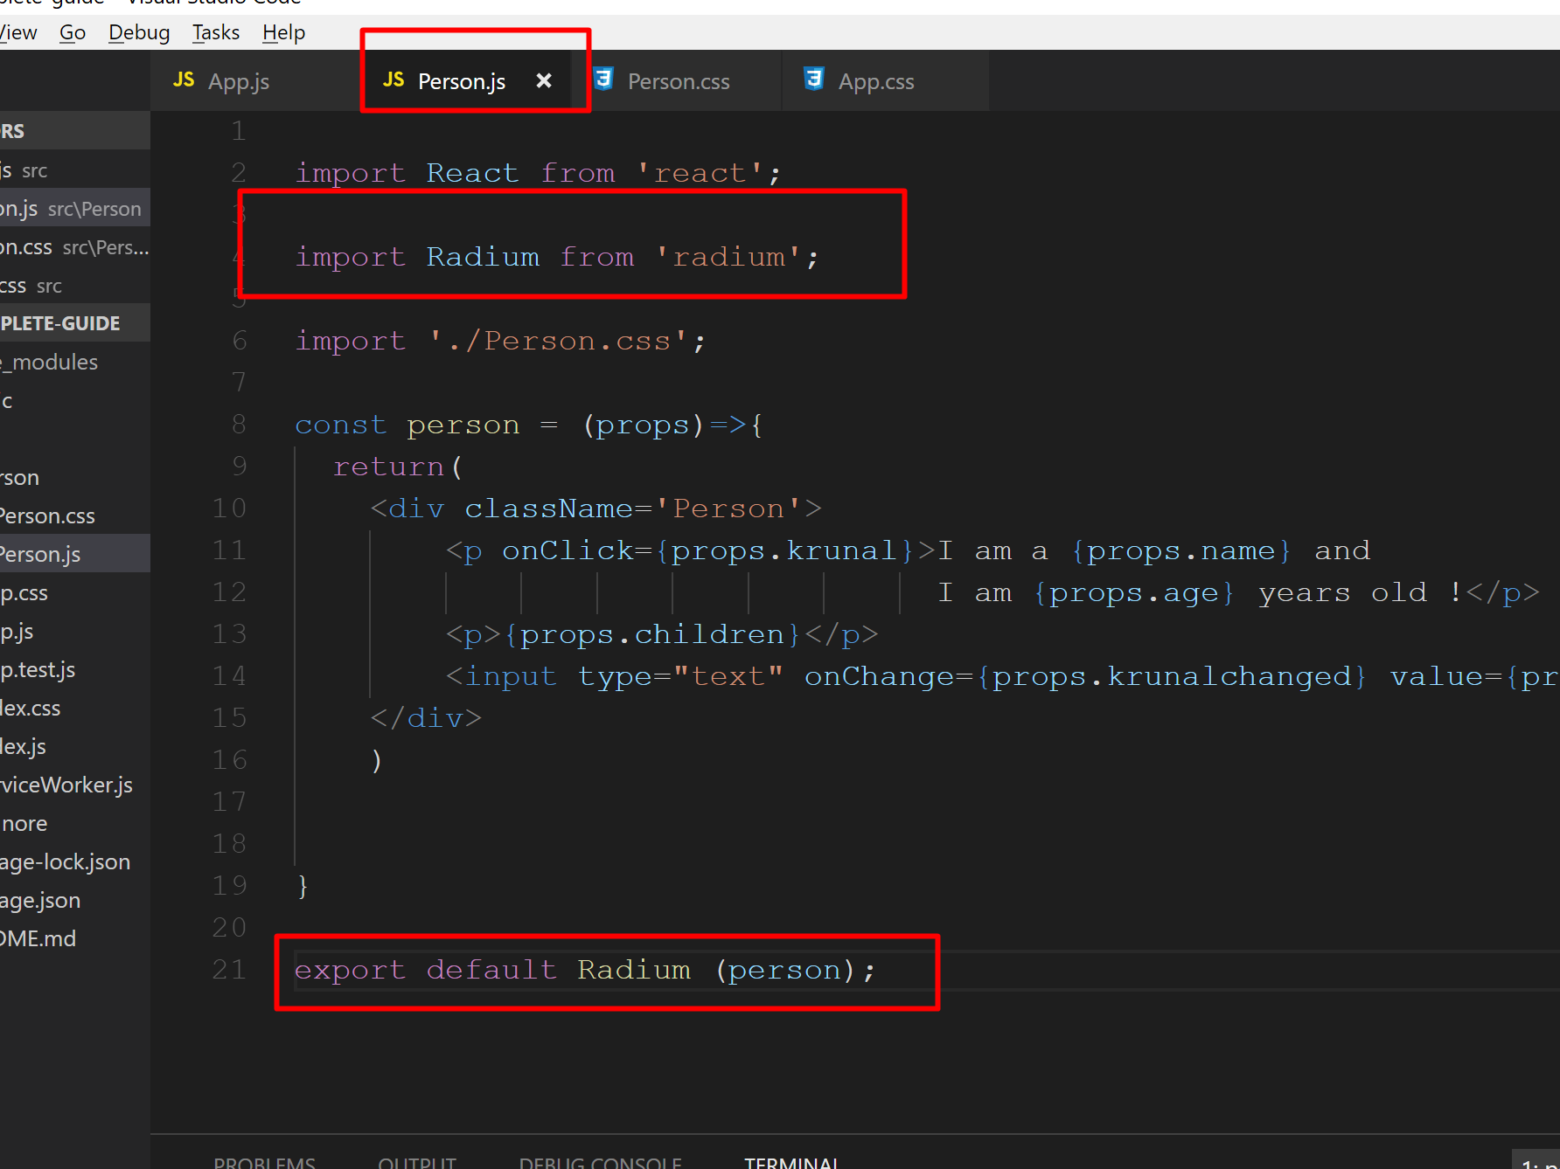
Same changes for Person.js file

Slide 43
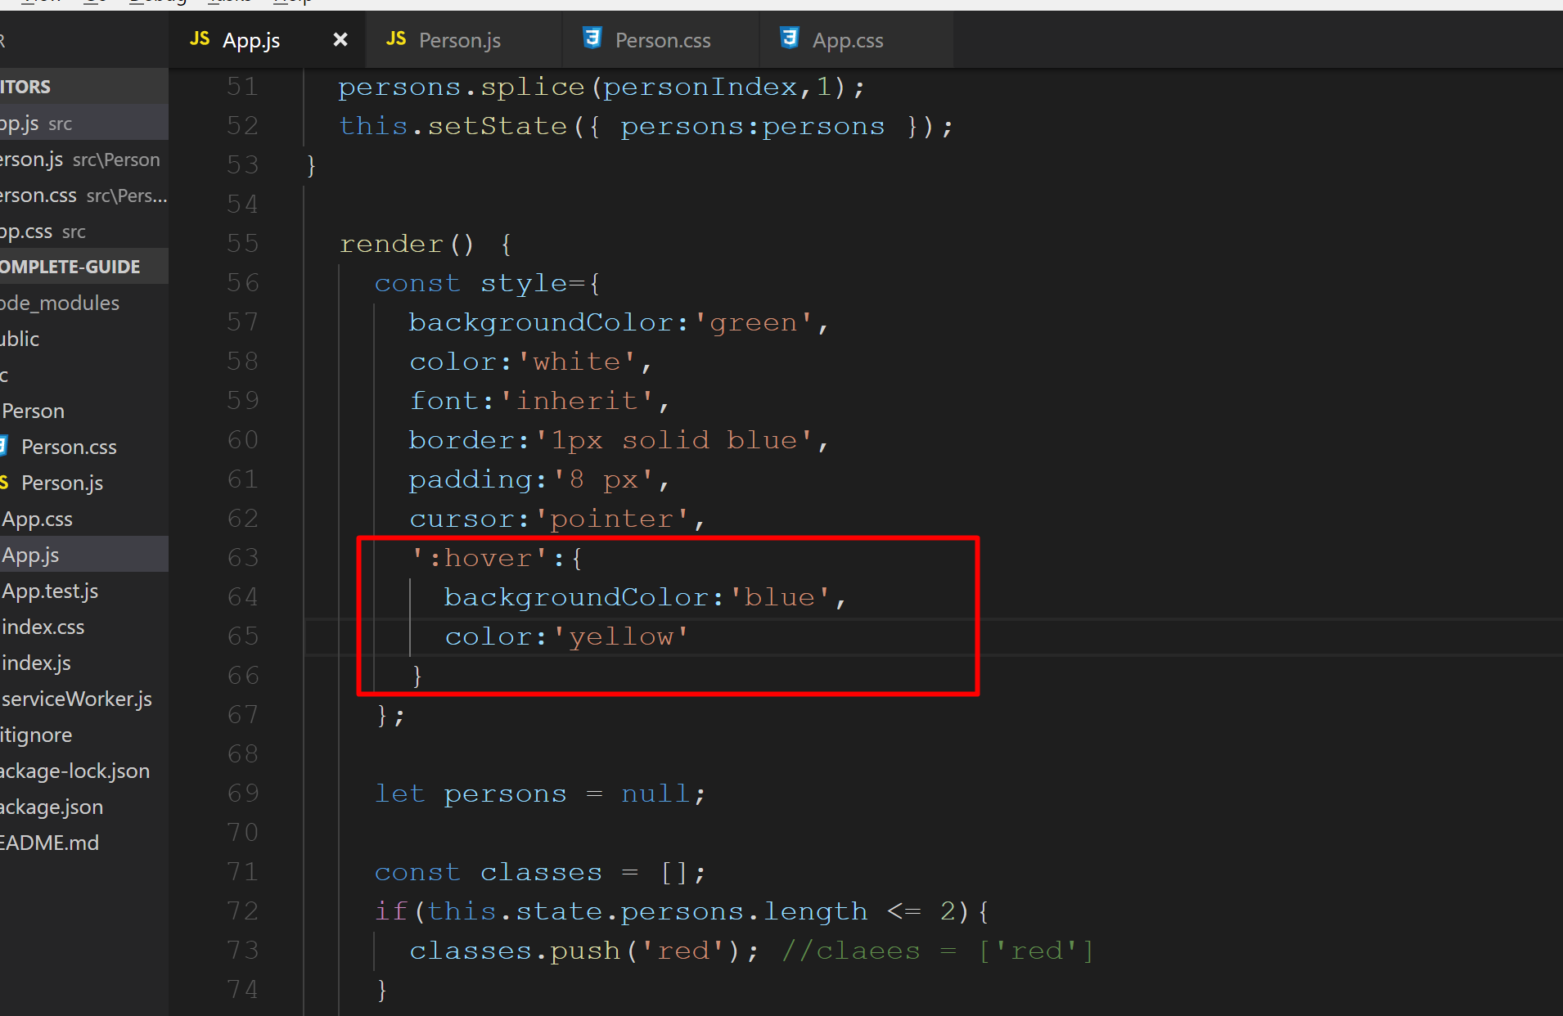
Add new value to the style. Here start with ‘’. Because we are using pseudo selector which begins with : and which is not a valid JavaScript variable syntax.

Slide 44
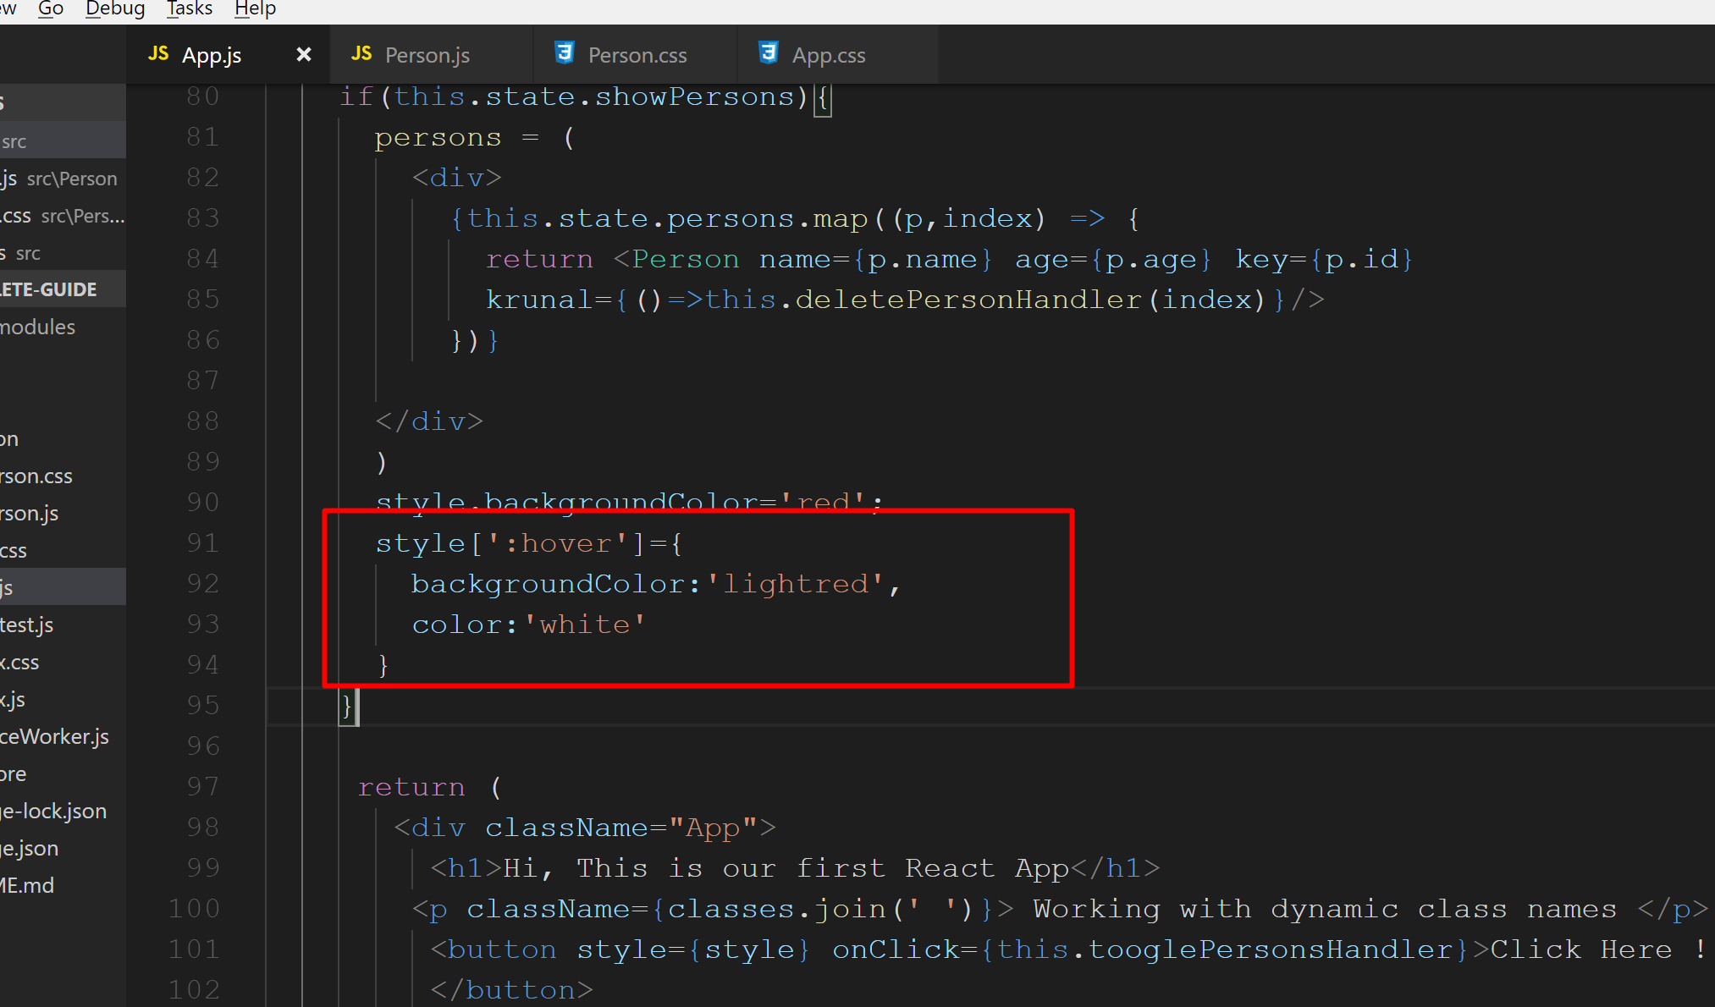
Also add style to the if() block as shown.

Slide 45
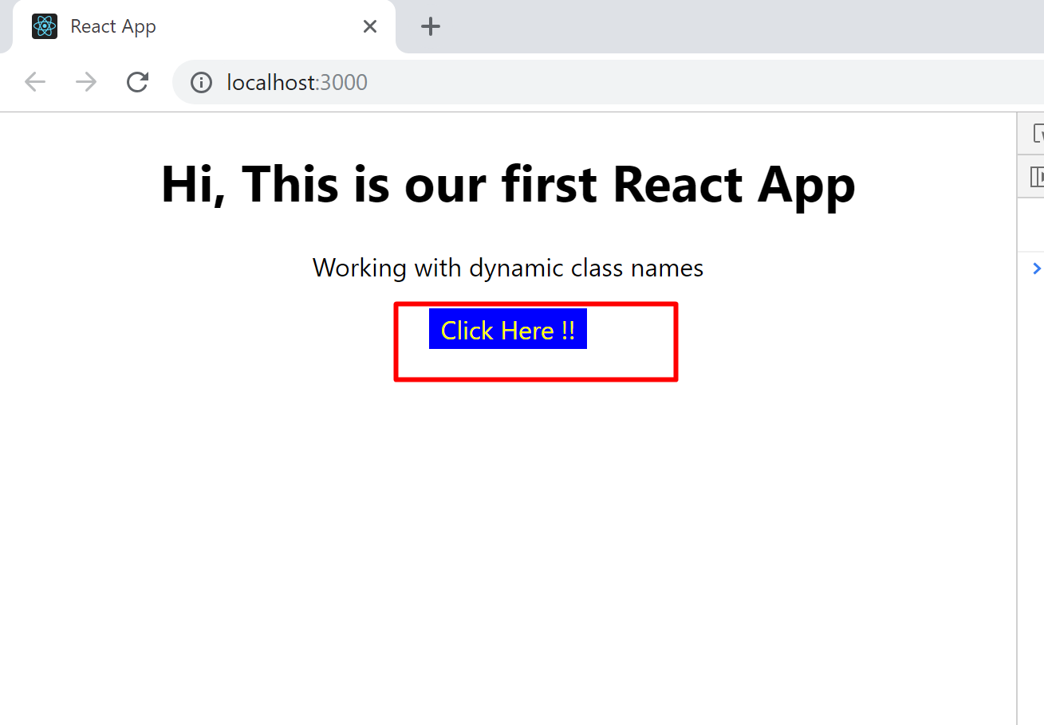
Run the application. Check the output. Hover over the button.

Slide 46
Enabling and Using CSS modules
Must do : Interesting, easy and new topics for all….
Adding Pseudo Selectors
Nice to do if time permits… very easy and interesting….

Slide 47
Components Deep Dive

Slide 48
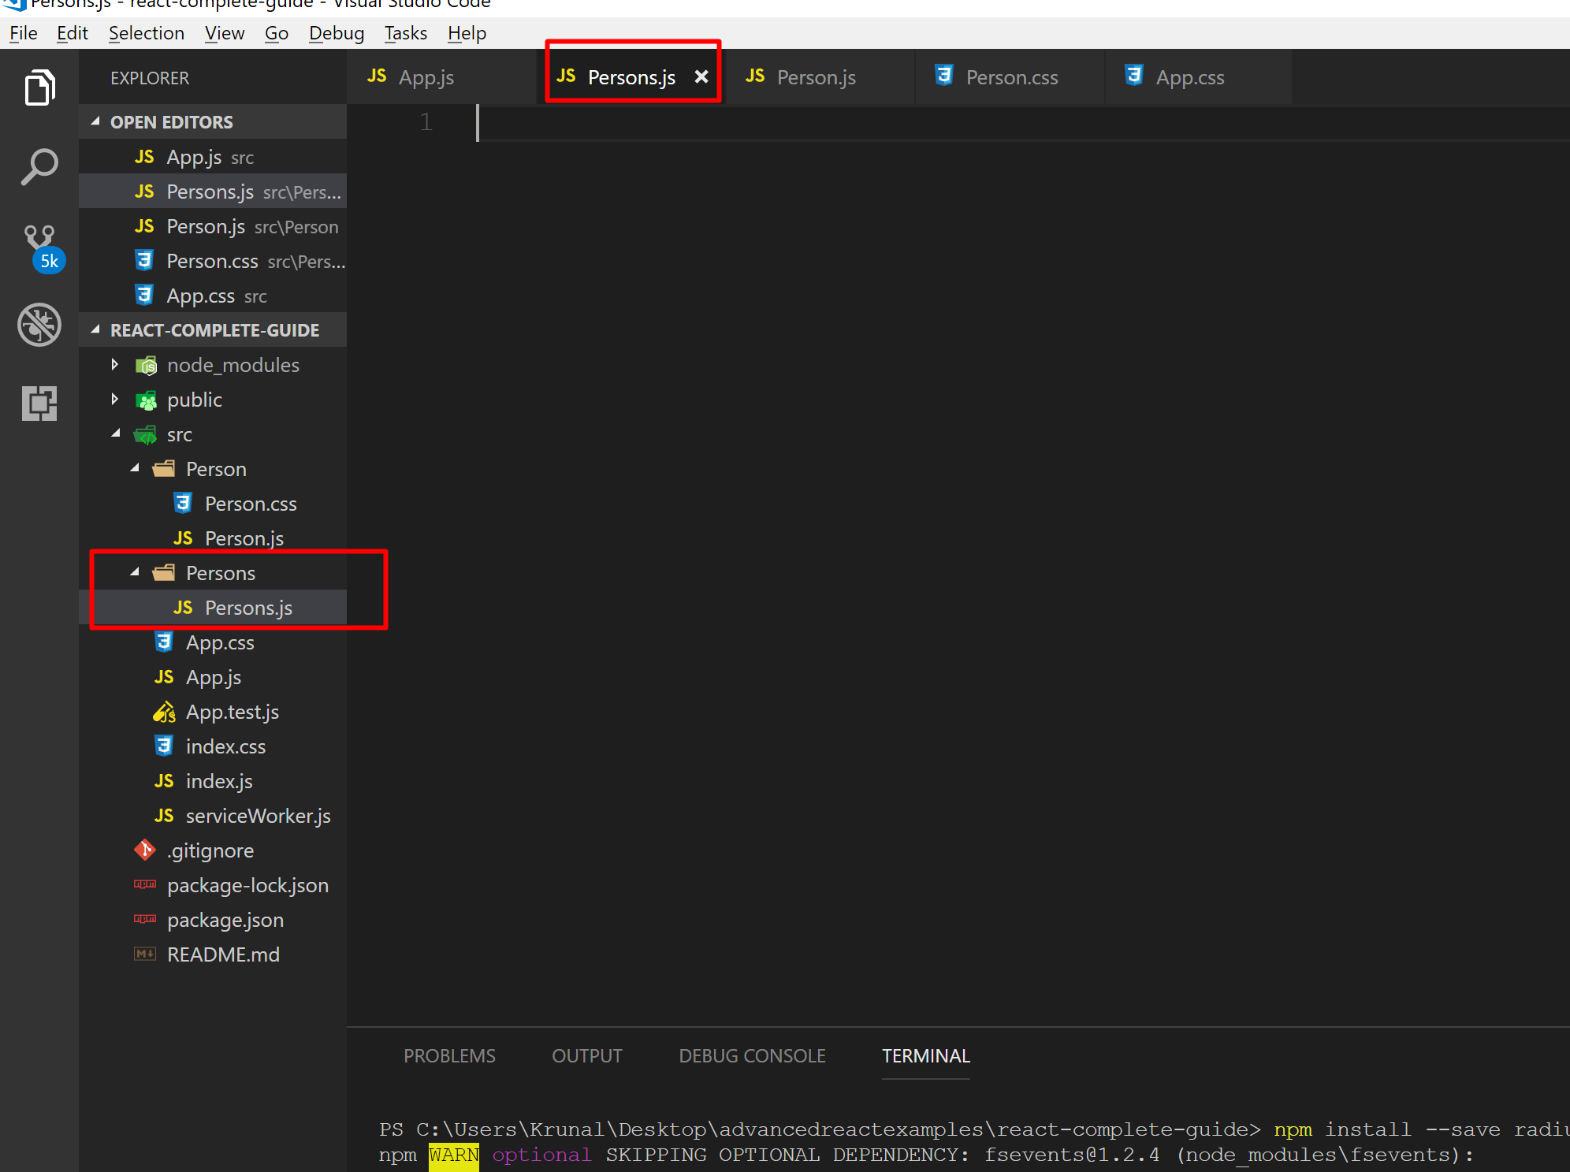
Right click on Src folder→Create New Folder called Persons. Within Persons folder create new file Persons.js

Slide 49
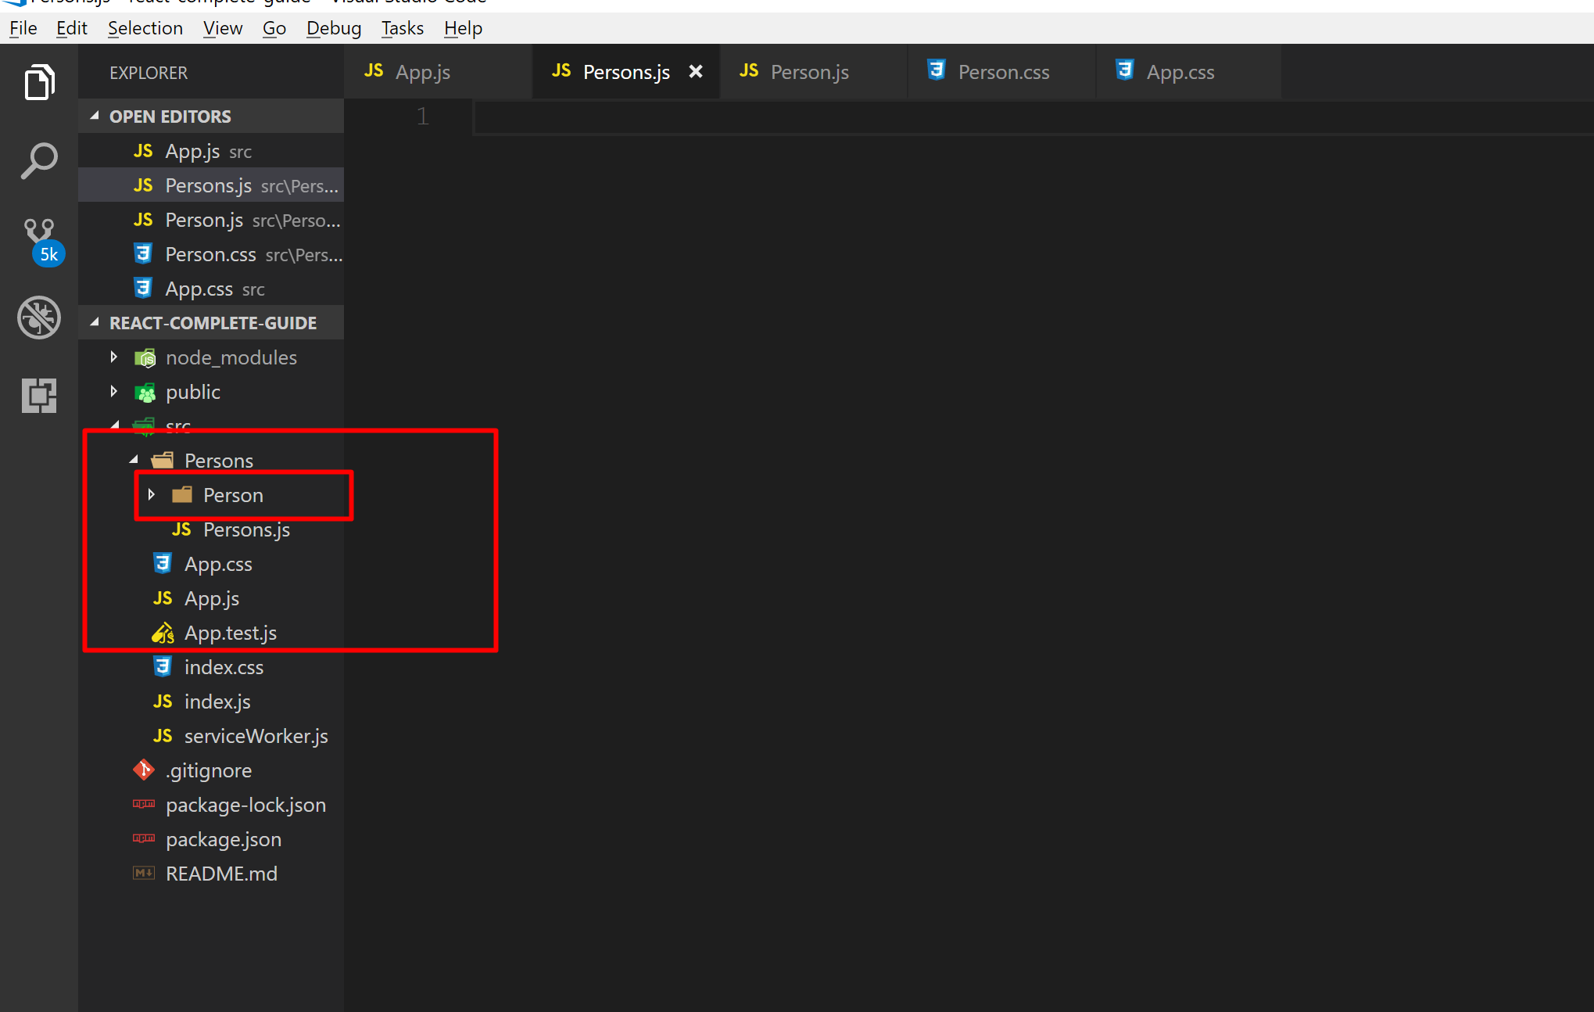
Move the Person folder inside Persons folder

Slide 50
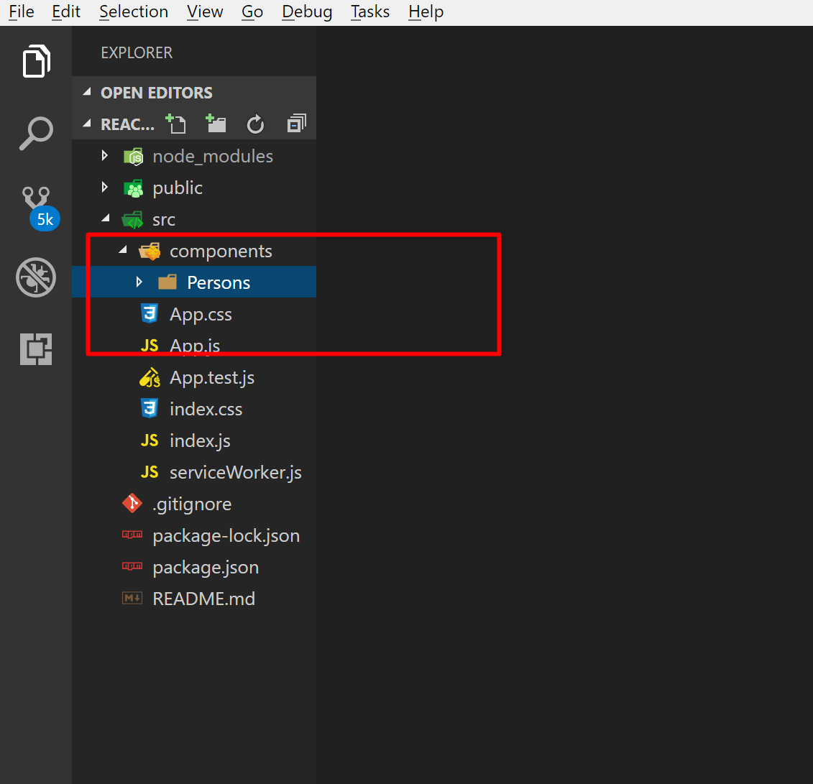
Also create a new folder called components and move the Persons folder inside components folder

Slide 51
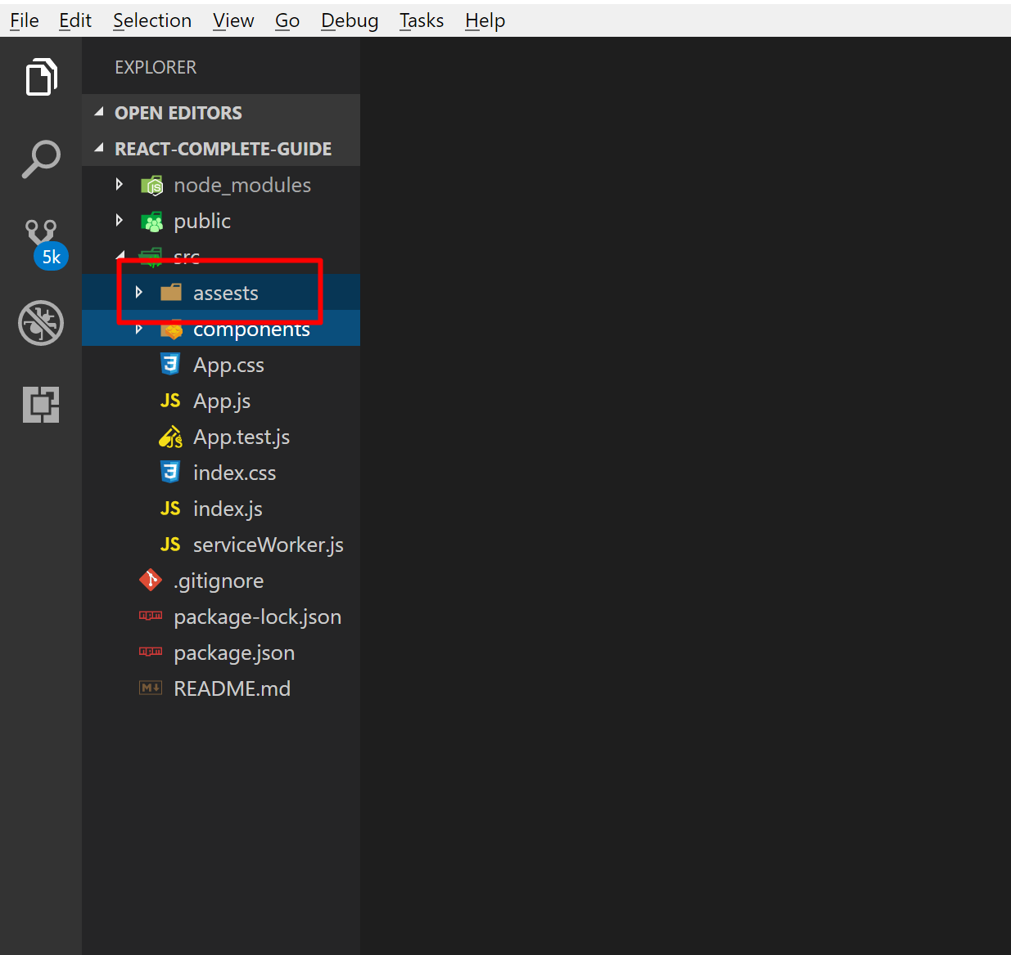
Inside src folder create a new folder called assests

Slide 52
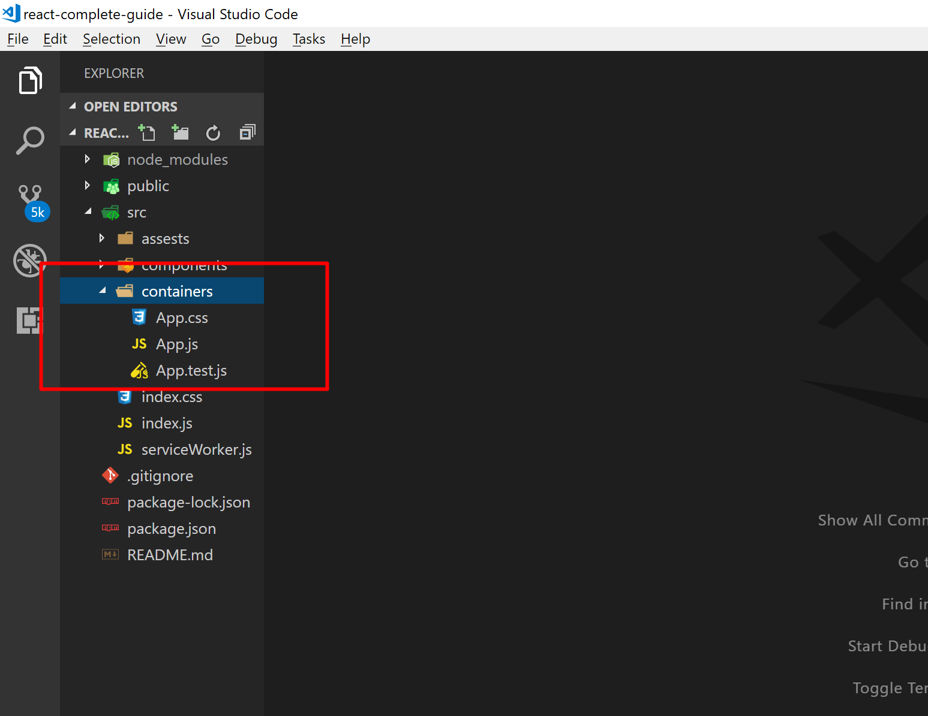
Right click on Src folder and create a new folder called containers. Move App.js, App.css and App.test.js file within container folder

Slide 53
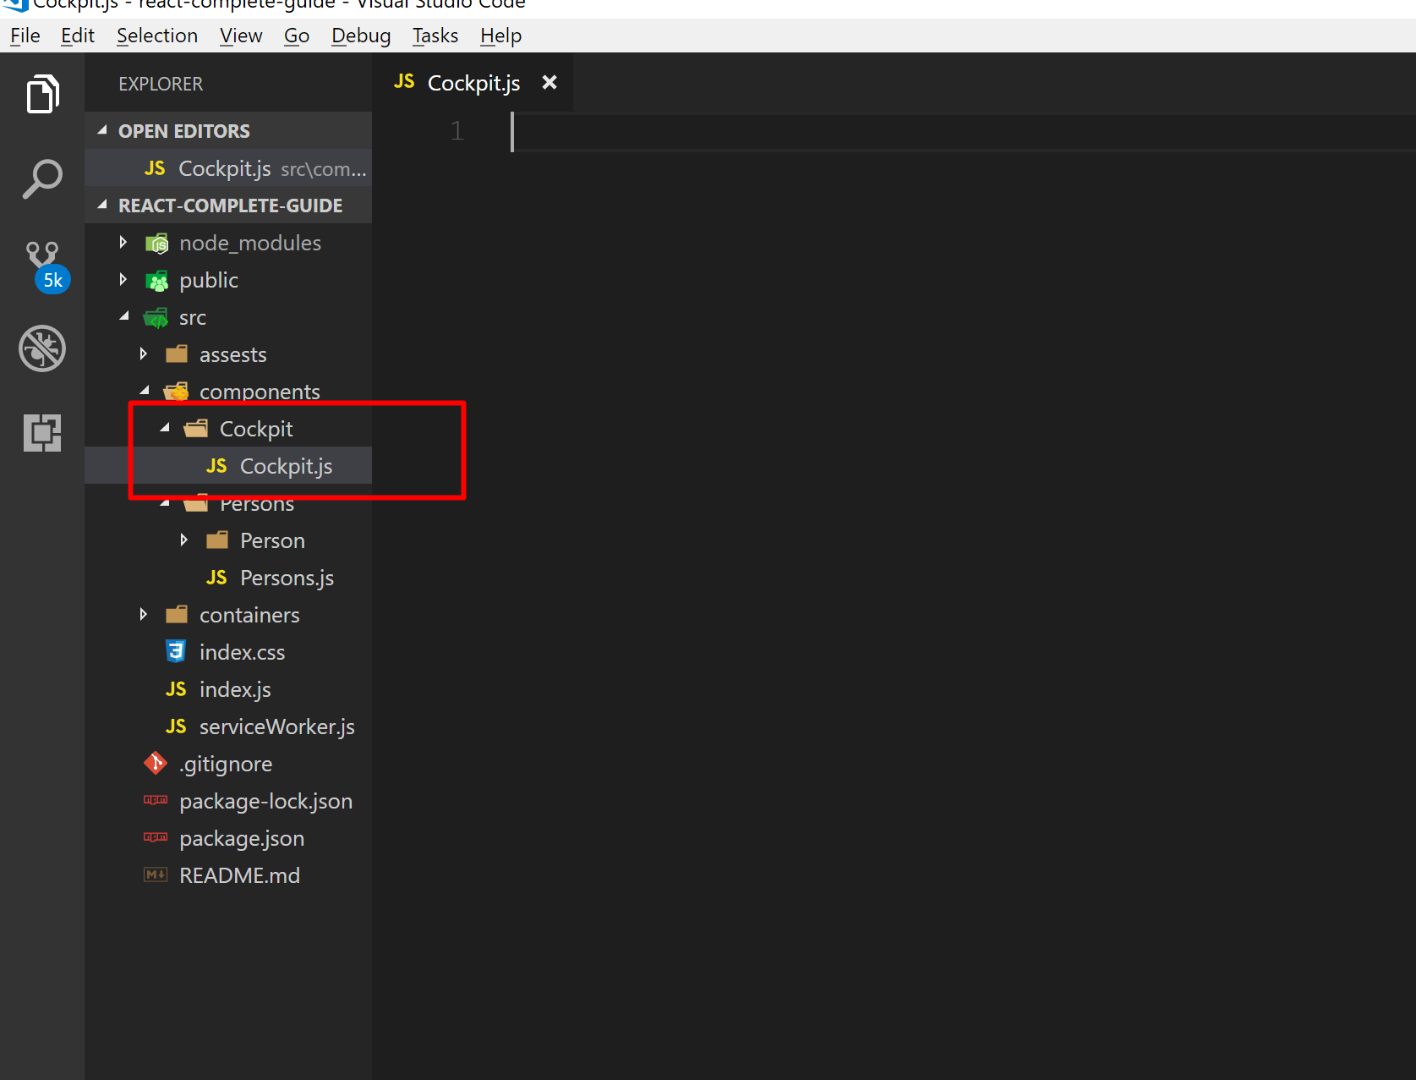
Right click on components folder and add new folder Cockpit. Add new file Cockpit.js

Slide 54
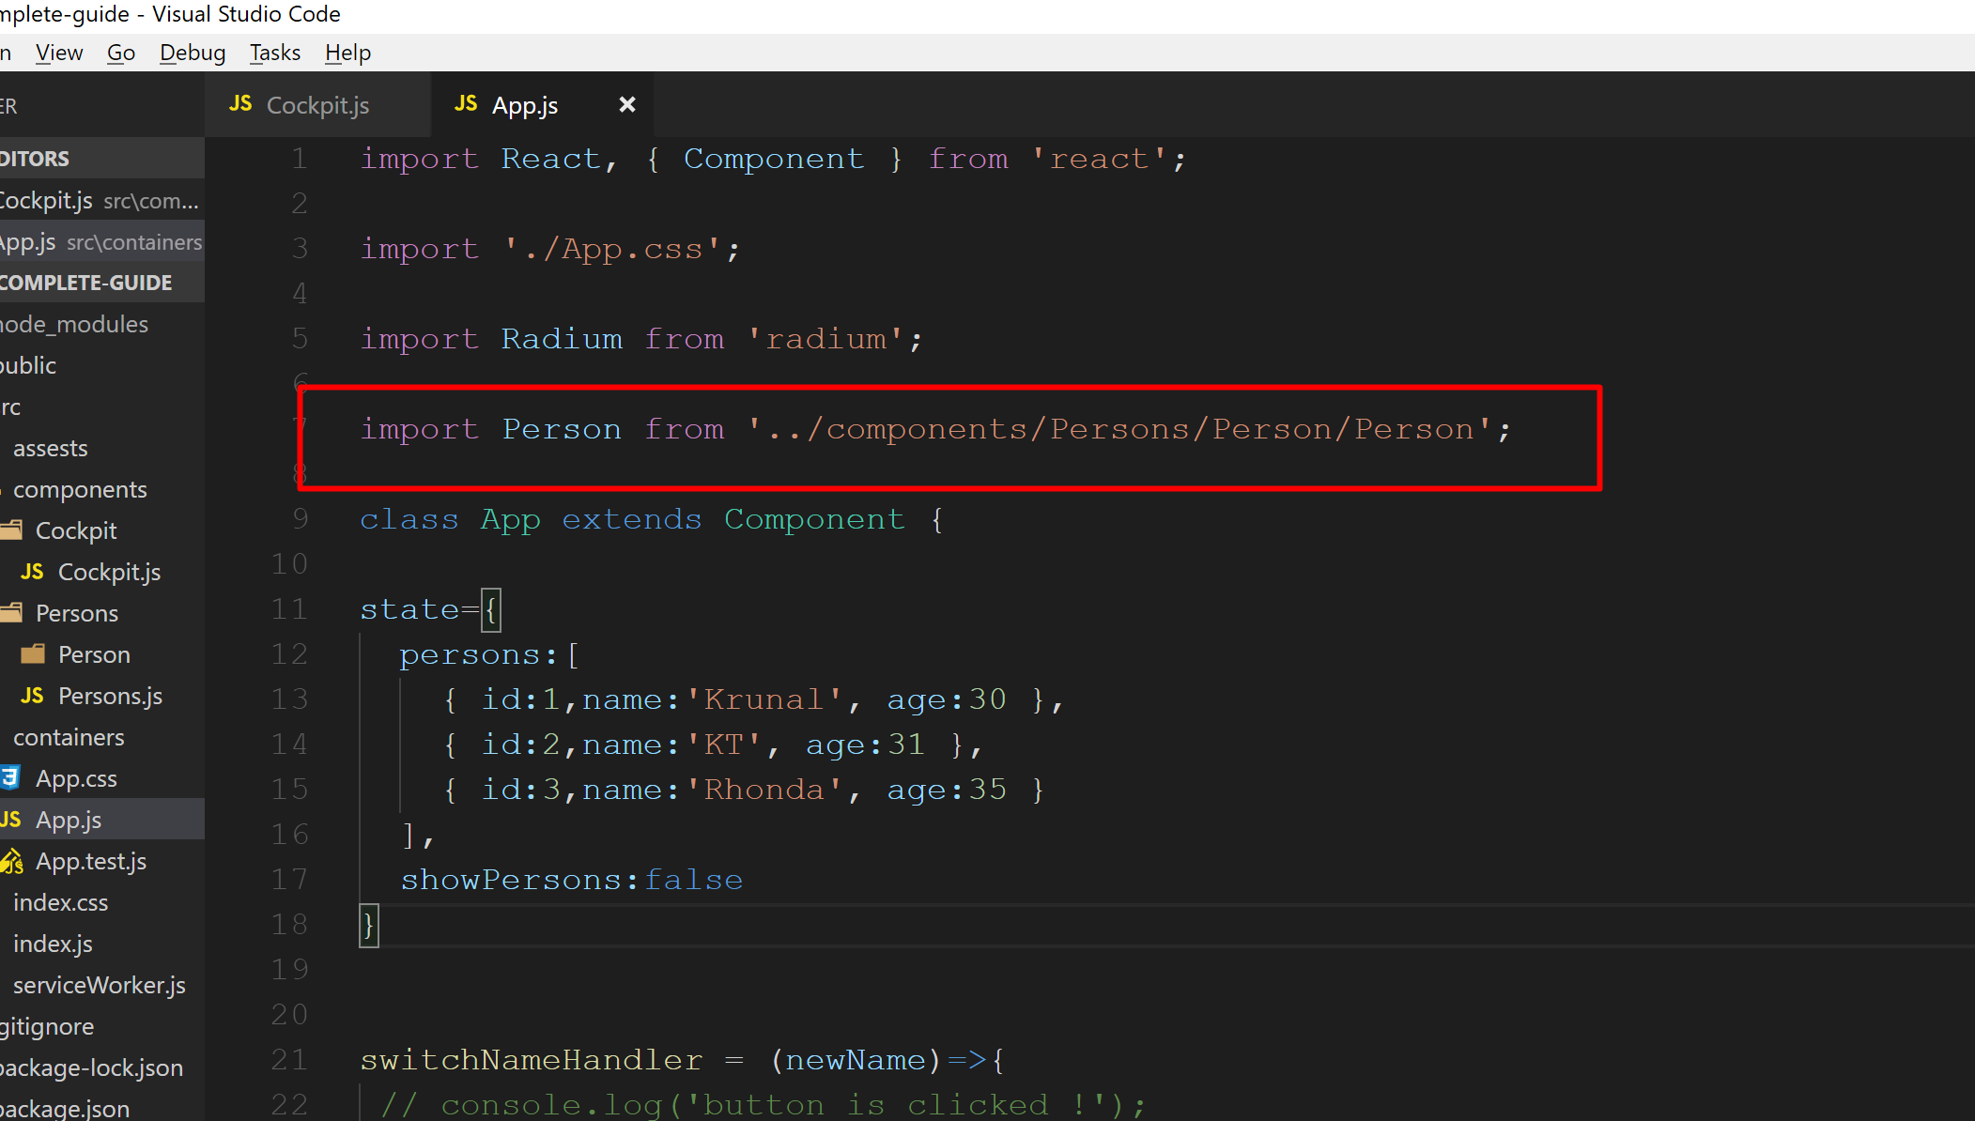
Obviously our app will not work now. So we have to correct all the imports. In the App.js file change the Path as shown below…

Slide 55
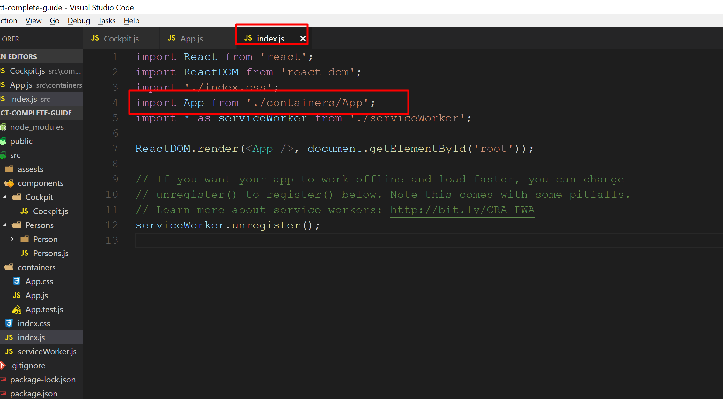
Open index.js file and modify import statement for App

Slide 56
Run the application and check the output.
Now your application should work fine.
Now we will work with Cockpit.js and Persons.js

Slide 57
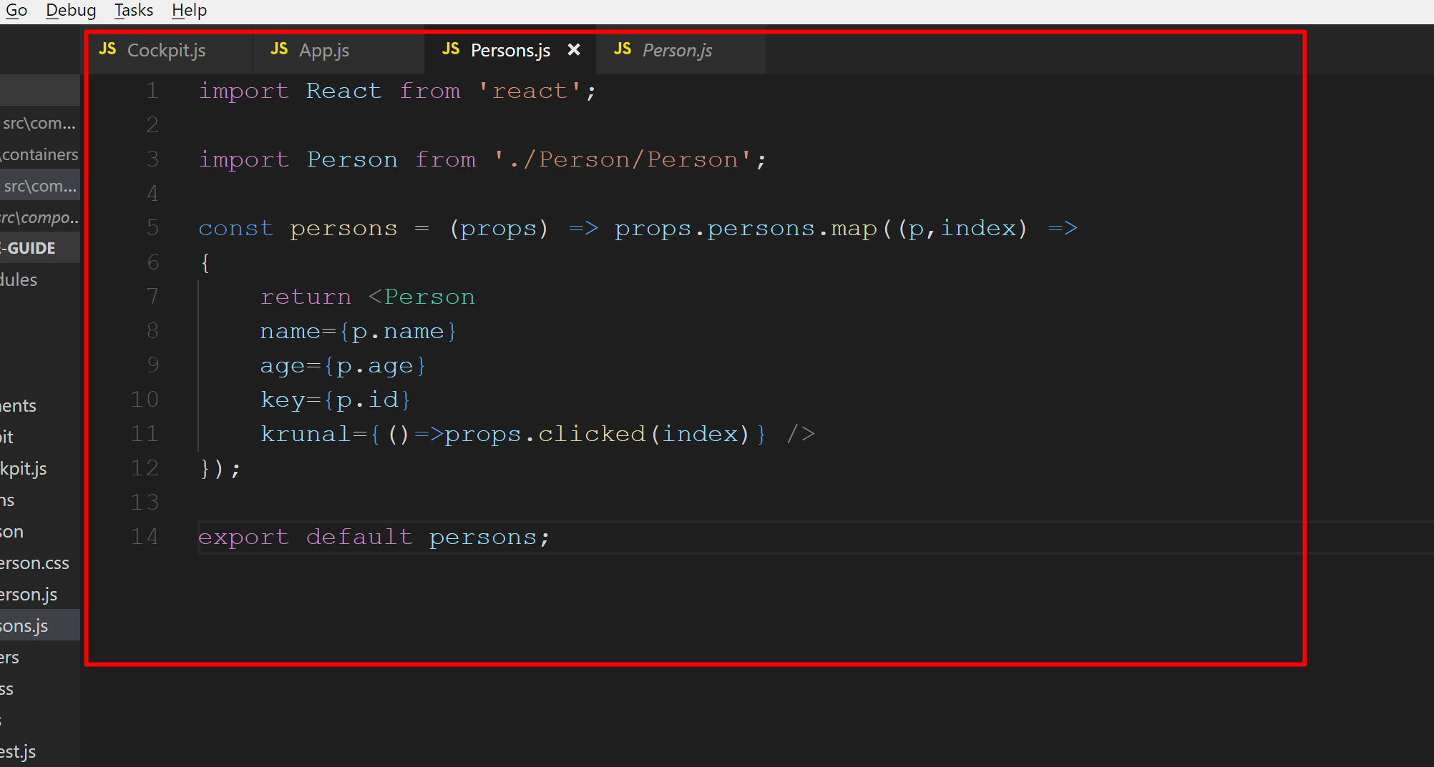
Prepare Persons.js

Slide 58
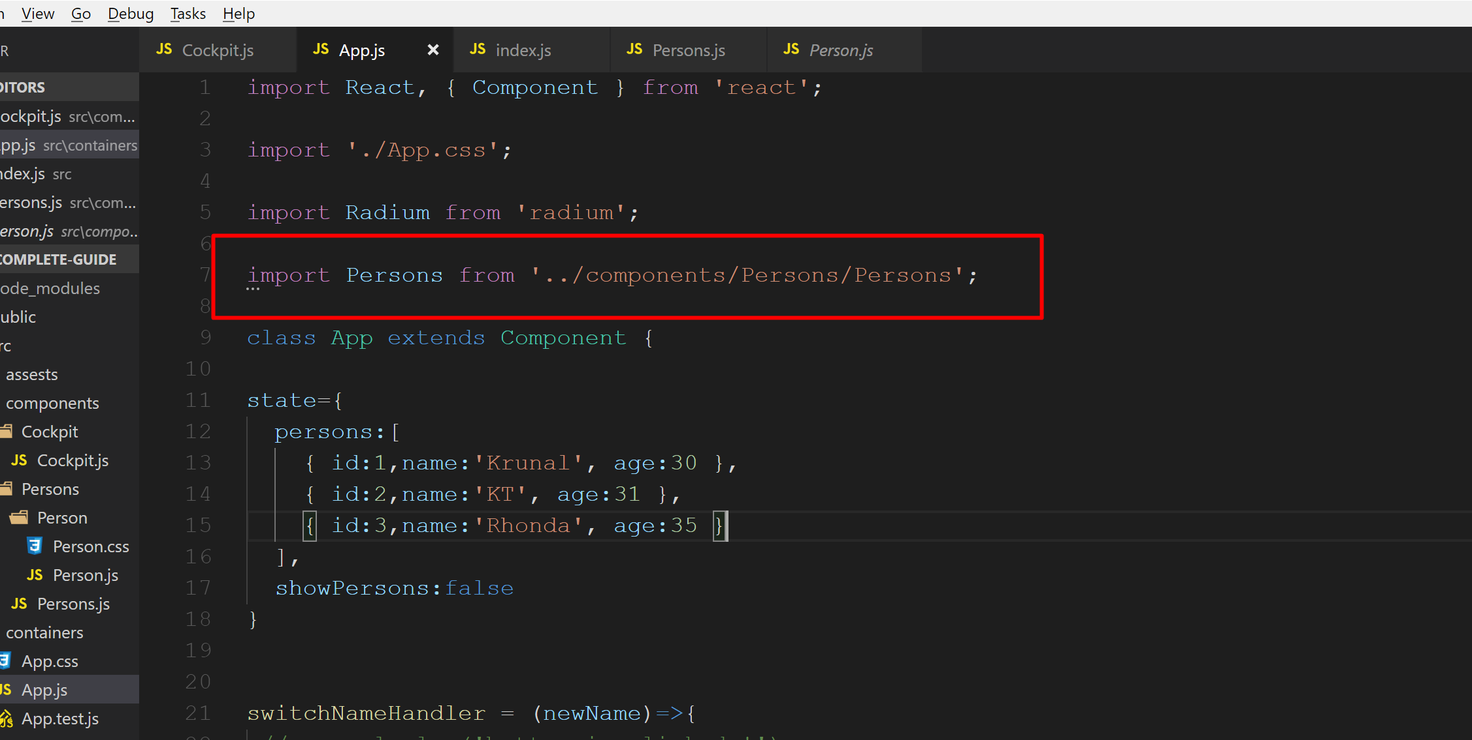
Open App.js file and modify import statement

Slide 59
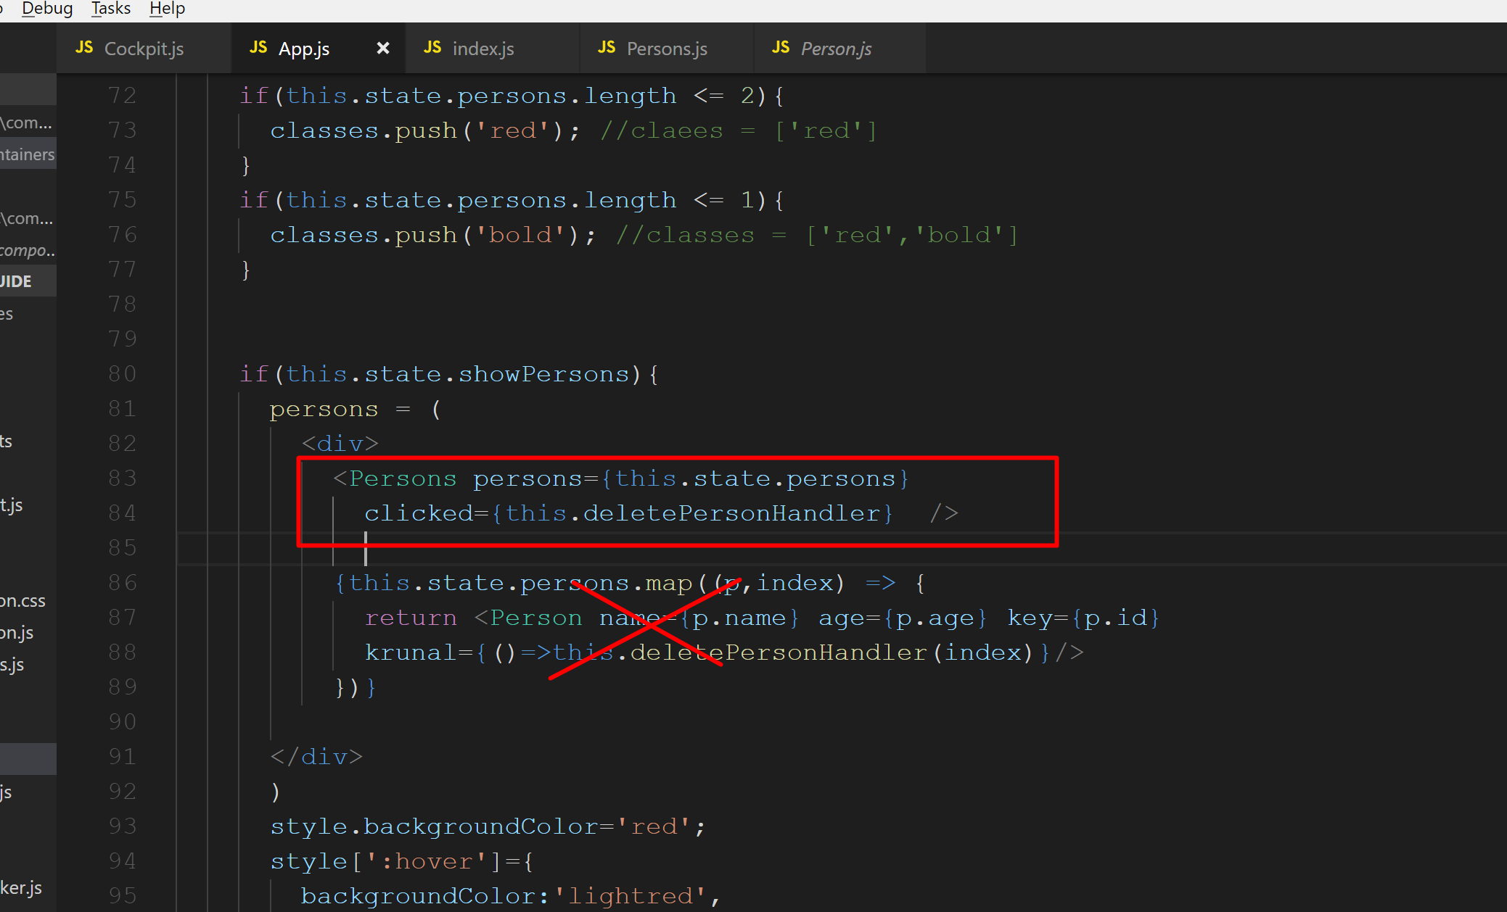
Import the Persons component and delete the old code

Slide 60
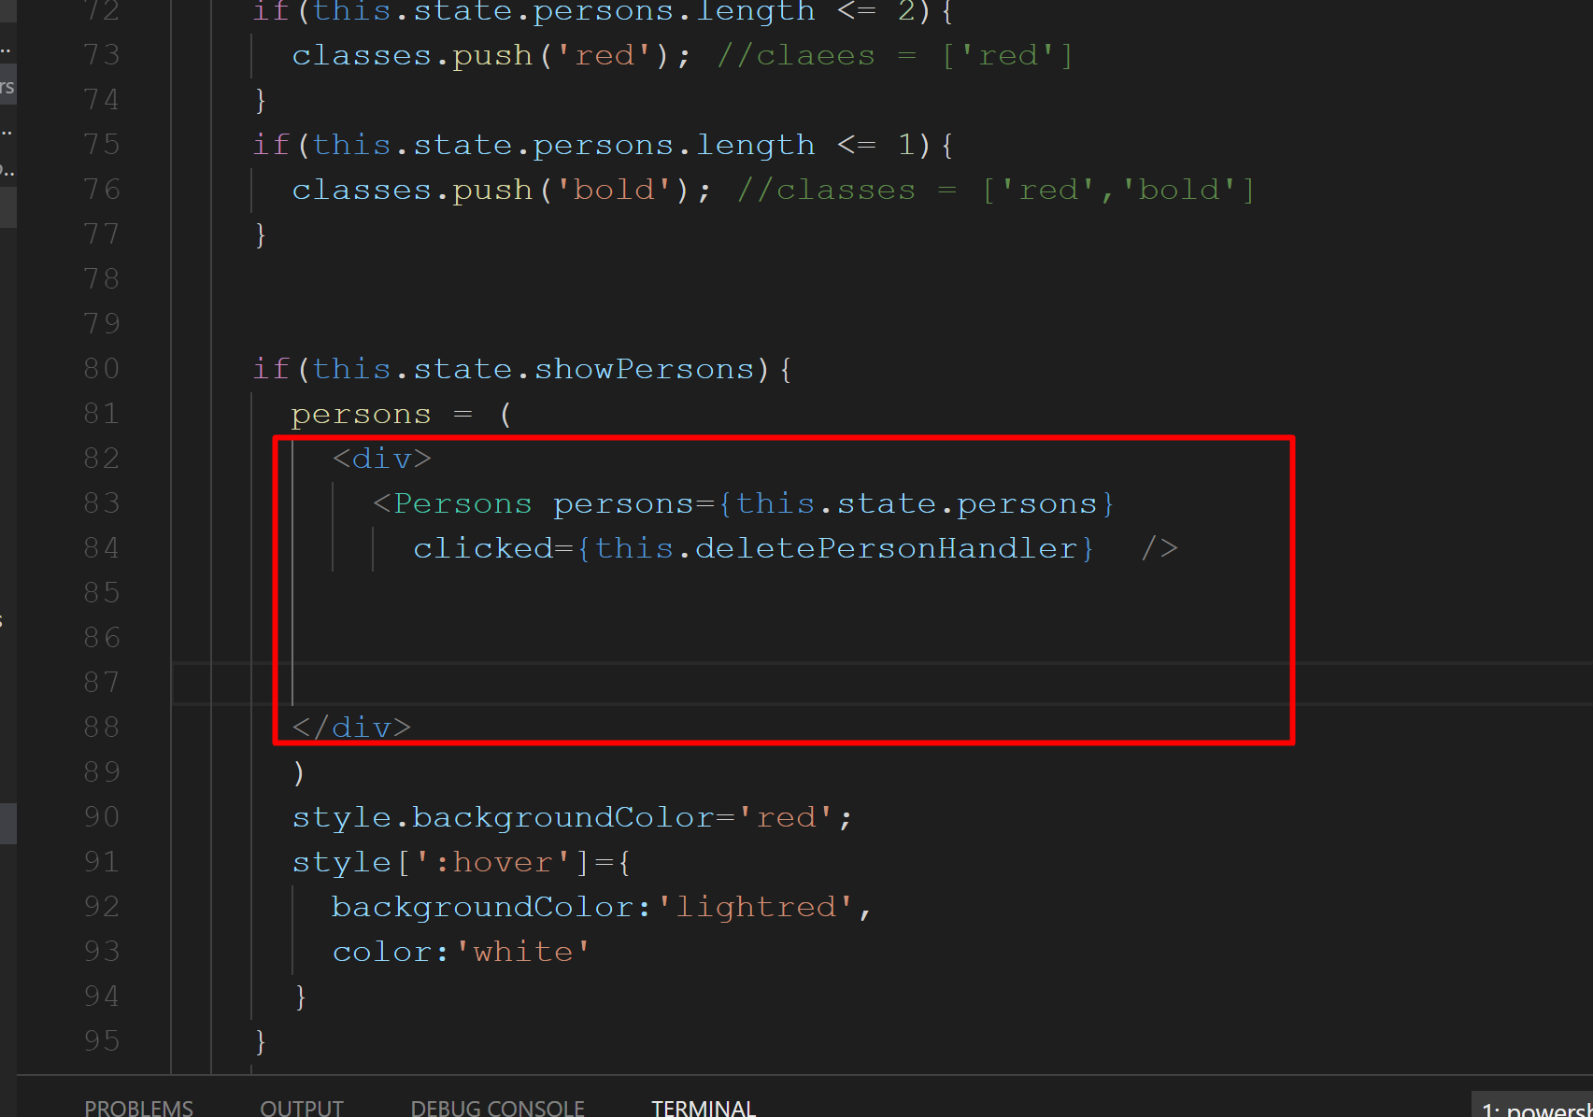
So finally, it would be like this…

Slide 61
Run the application. Check the output. It should work fine now…

Slide 62
Cockpit component is not done.. Do if time permits..

Slide 63
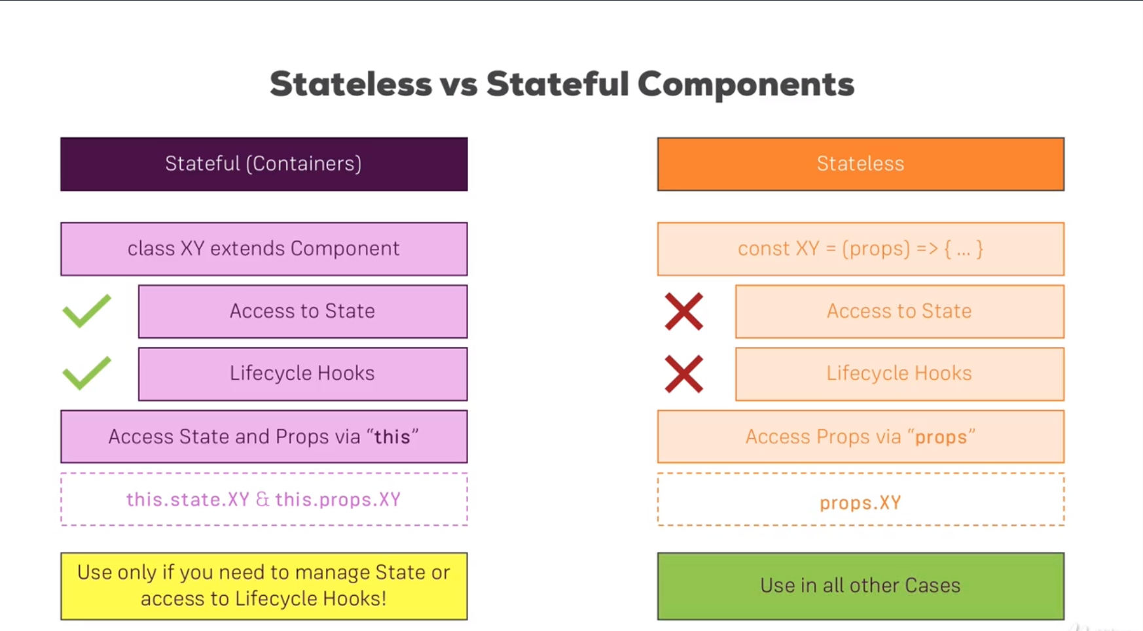

Slide 64
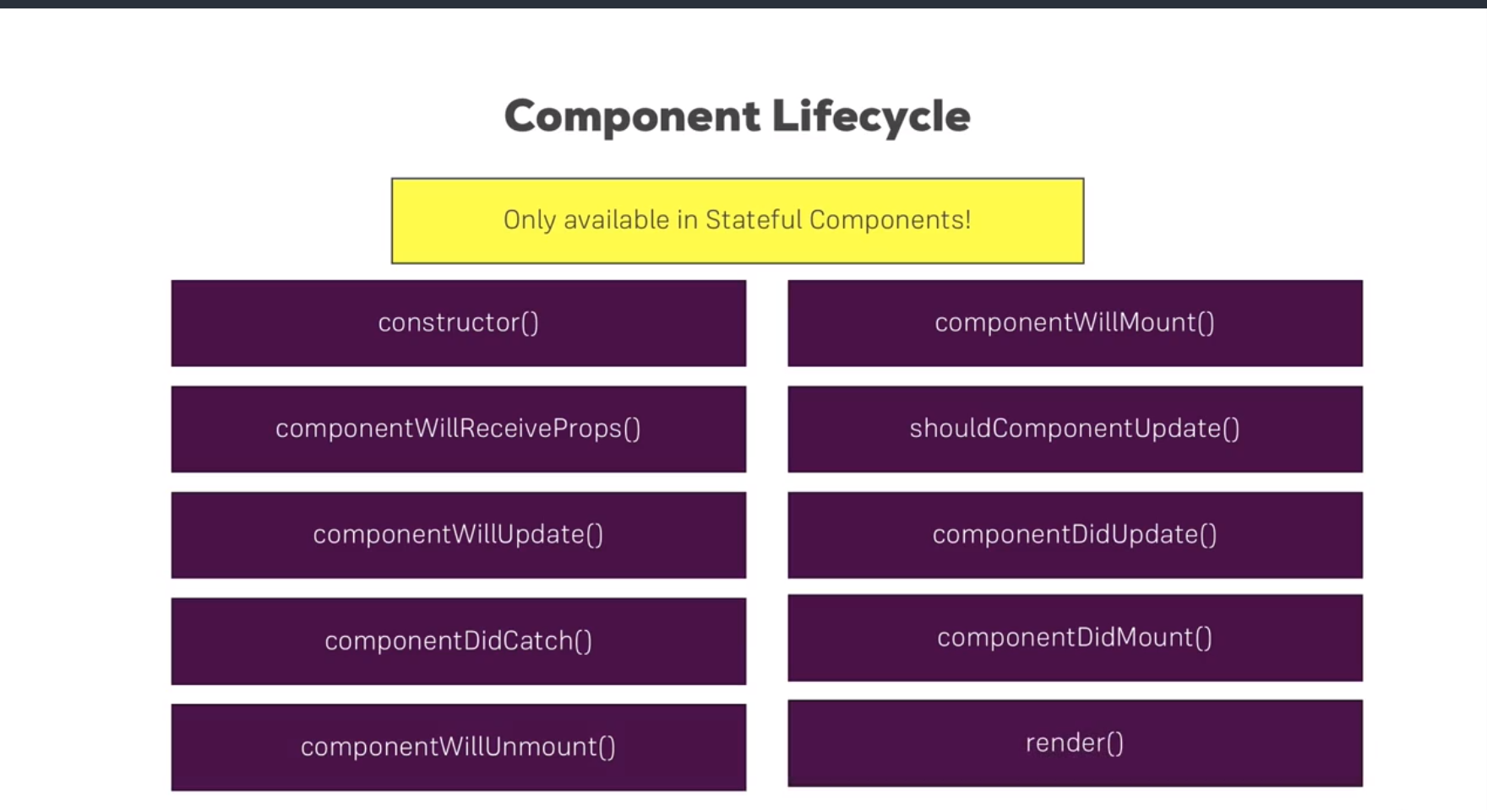
Component Lifecycle

Slide 65
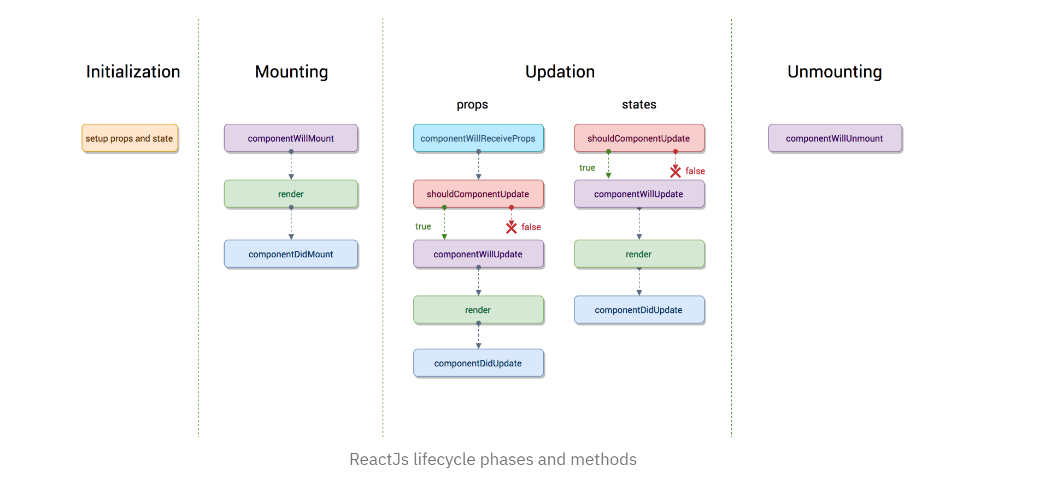

Slide 66


Slide 67


Slide 68


Slide 69
Stage 1 : Initialization
The component is setting up the initial state in the constructor, which can be changed later by using the setState method. The defaultProps is defined as a property of Component to define all the default value of props, which can be overridden with new prop values.

Slide 70
Stage 2 : Mounting
After preparing with basic needs, state and props, our React Component is ready to mount in the browser DOM. This phase gives hook methods for before and after mounting of components. The methods which gets called in this phase are:
componentWillMount is executed just before the React Component is about to mount on the DOM. Hence, after this method the component will mount. All the things that you want to do before a component mounts has to be defined here.
This method is executed once in a lifecycle of a component and before first render.
Usage: componentWillMount is used for initializing the states or props

Slide 71
render mounts the component onto the browser. This is a pure method, which means it gives the same output every time the same input is provided.

Slide 72
componentDidMount this is the hook method which is executed after the component did mount on the dom.
This method is executed once in a lifecycle of a component and after the first render.
As, in this method, we can access the DOM, we should initialize JS libraries like D3 or Jquery which needs to access the DOM.
The API calls should be made in componentDidMount method always.

Slide 73
Now let us convert our stateless component to stateful component.

Slide 74

Open Persons.js and modify it as shown below… We have converted our functional component to Stateful component

Slide 75
Run application. Check output. It should work normally as before.

Slide 76

Also do the same for Person component in Person.js file

Slide 77
Check the output. Application should work now as before.

Slide 78

Now we will understand component lifecycle here. Inside App.js file create constructor(). When we create constructor we have to pass super keyword. Constructor receives the props this component gets. Outside the constructor if we want to access props we have to use this.props but only within constructor it would be props. We also have to call super(props). Before we implement constructor it worked before react automatically reach out to the super constructor so to the constructor of the component we created. But if we implement our own one, we overwrite react’s default and therefor we have to do this.

Slide 79

Also add componentDidMount()

Slide 80

Also put console statement inside render method.

Slide 81

Run app and check console.

Slide 82

Add the same logic for Persons.js

Slide 83
If you run the application and check the console window, you can see only on the button click Persons component is getting triggerd.

Slide 84

Now, same thing for Person.js

Slide 85

Run application and check output.

